Slide 1
Scaling NWChem with Efficient and Portable Asynchronous Communication in MPI RMA
Min Si^{[1][2]}, Antonio J. Peña^{[1]}, Jeff Hammond^{[3]}, Pavan Balaji^{[1]}, Yutaka Ishikawa^{[4]}
[1] Argonne National Laboratory, USA
{msi, apenya, balaji}@mcs.anl.gov
[3] Intel Labs, USA
jeff_hammond@acm.org
[2] University of Tokyo, Japan
msi@il.is.s.u-tokyo.ac.jp
[4] RIKEN AICS, Japan
yutaka.ishikawa@riken.jp
Notes:
Have worked at Argonne for 1 year,

Slide 2
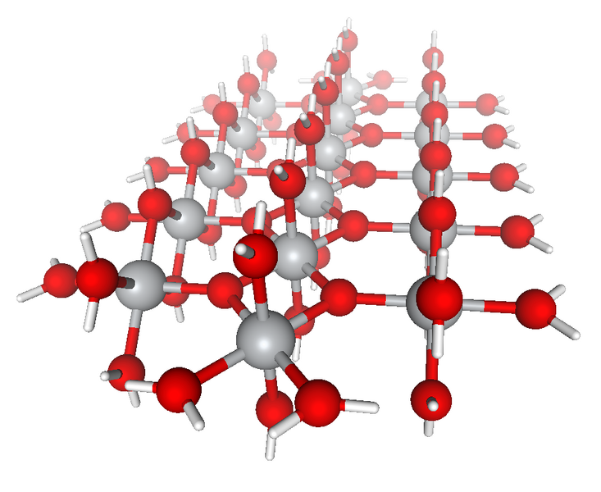
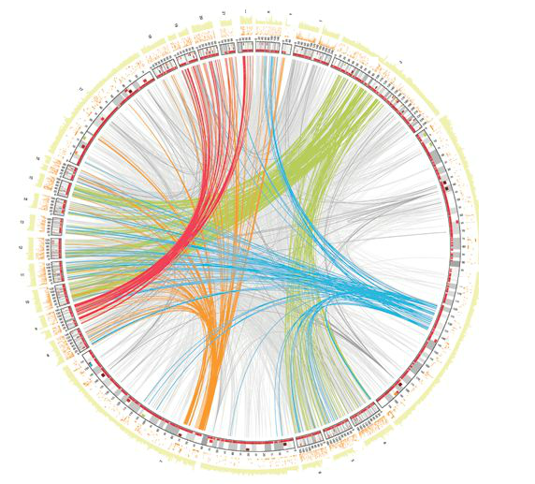
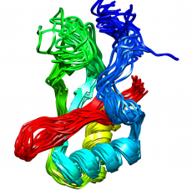
Large Chemical & Biological Applications
NWChem
Quantum chemistry application
SWAP-Assembler
Bioinformatics application
Molecular Dynamics
Simulation of physical movements of atoms and molecules for materials, chemistry and biology
…
Application Characteristics
Large memory requirement (cannot fit in single node)
Irregular data movement

Slide 3
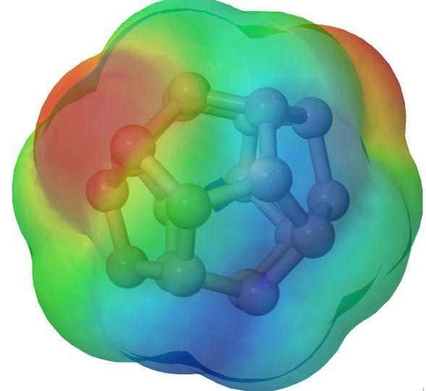
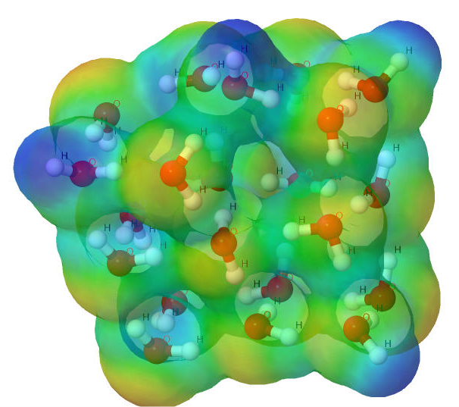
NWChem ^{[1]}
High performance computational chemistry application suite
Composed of many types of simulation capabilities
Molecular Electronic Structure
Quantum Mechanics/Molecular Mechanics
Pseudo potential Plane-Wave Electronic Structure
Molecular Dynamics
Carbon C₂₀
Water (H₂O)²¹
Pyrene C₁₆H₁₀
[1] M. Valiev, E.J. Bylaska, N. Govind, K. Kowalski, T.P. Straatsma, H.J.J. van Dam, D. Wang, J. Nieplocha, E. Apra, T.L. Windus, W.A. de Jong, "NWChem: a comprehensive and scalable open-source solution for large scale molecular simulations" Comput. Phys. Commun. 181, 1477 (2010)

Slide 4
Communication Runtime
Abstractions for distributed arrays
Global Address Space
Applications
Applications
Applications
Physically distributed to different processes
Global Arrays ^{[2]}
ARMCI : Communication interface for RMA^{[3]}
Hidden from user
ARMCI native ports
ARMCI-MPI
IB
DMMAP
…
MPI RMA
IB
Cray
…
IB
Cray
Tianhe-2
…
K
Limited platforms
Long development cycle time for supporting new platform
Portable implementation on top of MPI
Support most platforms !
[2] http://hpc.pnl.gov/globalarrays
[3] http://hpc.pnl.gov/armci

Slide 5
Get-Compute-Update
Typical Get-Compute-Update mode in GA programming
Pseudo code
for i in I blocks:
for j in J blocks:
for k in K blocks:
GET block a from A
GET block b from B
c += a * b /*computing*/
end do
ACC block c to C
end do
end do
GET block a
GET
block b
Accumulate block c
Perform DGEMM in local buffer

Slide 6
Outline
Problem Statement
Solution
Evaluation
Experimental Environment
NERSC*'s newest supercomputer
Cray XC30
2.57 Petaflops/s peak performance
133,824 compute cores…
*National Energy Research Scientific Computing Center

Slide 7
NWChem CCSD(T) simulation
Internal steps in CCSD(T) task
“Gold standard” CCSD(T)
Pareto optimal point of high accuracy relative to computational cost
Top of the three-tiered pyramid of methods used for ab initio calculations
Self-consistent field (SCF)
Four-index transformation (4-index)
CCSD iteration
(T) portion
CCSD(T) internal steps in varying water problems
CCSD(T)
MP2
SCF
We are here
O(N⁷)
More accuracy
More computation
O(N⁵)
(T) portion consistently dominates the entire cost by close to 80%.
O(N³)
Notes:
CCSD(T) is the "gold standard" quantum chemistry method, which means
that it provides a very high accuracy relative to computational cost,
and in particular, it is a Pareto optimal point
This means that, to
get more accurate than CCSD(T), one needs _substantially_ more
computation, and if one chooses a less accurate method, the loss in
accuracy is greater than the savings in computation.
In any case, CCSD(T) is the most widely used high accuracy method in
quantum chemistry, and it is at the top of the three-tiered pyramid of
methods used for ab initio (quantum mechanical) calculations:
Most chemistry studies use a combination of these, with CCSD(T)
applied judiciously to ensure the accuracy of the less expensive
methods.
As for what CCSD(T) is, the CCSD part is the iterative evaluation of
the coupled-cluster wavefunction with singles and doubles (or singly-
and doubly-excited clusters).
The (T) is an a posteriori error
correction based upon the perturbative approximation of triples (or
triply-excited clusters) complete through 4th-order, with inclusion of
a subset of 5th-order terms determined empirically to be necessary by
Pople* and coworkers.
The (T) computation is non-iterative, at least
in a canonical formulation (which is what we are doing).

Slide 8
How to determine SCALABILITY ?
Parallel Efficiency
Execution time on minimal number of cores α as base T₁
If base execution is not efficient ?
i.e., inefficient communication
Computational Efficiency
Focus on overhead of inefficient communication
Computation time on minimal number of cores as α base T_{comp}
High base T_{α}
Artificially High PE(N) !

Slide 9
Is (T) Portion Efficient ?
Parallel Efficiency
Computational Efficiency
(T) Portion strong scaling for W₂₁
(T) Portion profiling for W₂₁
Not efficient !

Slide 10
WHY (T) Portion Is Not Efficient ?
One-sided operations are not truly one-sided
On most platforms, some operations (e.g., 3D accumulates of double precision data) still have to be done in software
Cray MPI (default mode) implements all operations in software
Process 0
Process 1
Software implementation of one-sided operations means that the target process has to make an MPI call to make progress.
RMA (data)
Computation
Extreme communication delay in computation-intensive (T) portion
in large scale problems
Delay
MPI call
Challenge
How to improve asynchronous progress in communication with minimal impact on computation ?

Slide 11
Outline
Problem Statement
Solution
Evaluation

Slide 12
Traditional Approaches of ASYNC Progress
Thread-based approach
Every MPI process has a communication dedicated background thread
Background thread polls MPI progress process
Interrupt-based approach
Assume all hardware resources are busy with user computation on target processes
Utilize hardware interrupts to awaken a kernel thread
Cons:
Waste 50% computing cores or oversubscribe cores
Overhead of Multithreading safety of MPI
Cons:
Overhead of frequent interrupts
P0
T0
P1
T1
P2
T2
P3
T3
DMMAP-based ASYNC overhead on Cray XC30

Slide 13
Our Solution: Process-based ASYNC Progress
Multi- and many-core architectures
Rapidly growing number of cores
Not all of the cores are always keeping busy
Casper ^{[4]}
Dedicating arbitrary number of cores to “ghost processes”
Ghost process intercepts all RMA operations to the user processes
P0
P1
P2
…
PN
G0
G1
No multithreading / interrupts overhead
Flexible core deployment
Portable PMPI redirection
Ghost Process
Process 0
Process 1
Process 0
Process 1
Acc(data)
Computation
+=
RMA(data)
Computation
MPI call
Original communication
Communication with Casper
[4] M. Si, A. J. Pena, J. Hammond, P. Balaji, M. Takagi, and Y. Ishikawa, “Casper: An asynchronous progress model for MPI RMA on many-core architectures,” in Parallel and Distributed Processing (IPDPS), 2015.
Notes:
Infinite cores, do not need interrupt

Slide 14
Outline
Problem Statement
Solution
Evaluation
Experimental Environment
12-core Intel Ivy Bridge * 2 (24 cores) per node
Cray MPI v6.3.1

Slide 15
[DEMO] Core Utilization in CCSD(T) Simulation
DONE
Core Utilization (%)
Original MPI (no ASYNC)
Casper ASYNC
25%
50%
75%
100%
25%
50%
75%
100%
COMM
Concurrent COMM & COMP
Task Processing (%)
Task Processing (%)
0
25%
50%
75%
100%
0
25%
50%
75%
100%
COMP
Higher Computation Utilization is Better !
Core Utilization (%)
25%
50%
75%
100%
25%
50%
75%
100%
100%
100%
75%
75%
50%
50%
Oversubscribed ASYNC cores are polling MPI progress
25%
25%
0
Threads ASYNC on oversubscribed cores
0
Threads ASYNC on dedicated cores
Notes:
Mention too many core hours to finish the demo for w21..

Slide 16
Strong Scaling of (T) Portion for W21 Problem
CCSD(T) simulation processing
Core deployment
 | # COMP | # ASYNC
Original MPI | 24 | 0
Casper | 23 | 1
Thread (O) (with oversubscribed cores) | 24 | 24
Thread (D) (with dedicated cores) | 12 | 12
(H₂O)²¹
Computation-intensive (T)
Execution time
Computational efficiency
Improved!
Reduced !

Slide 17
WHY We Achieve ~100% Efficiency ?
 | # COMP | # ASYNC
Original MPI | 24 | 0
Casper | 23 | 1 | Loss only 1 (4%) COMP cores
Thread (O) (with oversubscribed cores) | 24 | 24 | Core oversubscription
Thread (D) (with dedicated cores) | 12 | 12 | Loss 50% COMP cores
W21 using 1704 cores
W21 using 6144 cores

Slide 18
Summary
NWChem CCSD(T) with Casper ASYNC
COMM
COMP
Core Utilization (%)
NWChem CCSD(T) with original MPI
(no ASYNC)
Core Utilization (%)
25%
50%
75%
100%
Task Processing (%)
25%
50%
75%
100%
Task Processing (%)
+ Casper
0
25%
50%
75%
100%
0
25%
50%
75%
100%
Only 50% Computational Efficiency
Close to 100% Computational Efficiency
We scale NWChem simulations
We utilize portable & scalable MPI Asynchronous Progress
We scale water molecule problems at ~100% parallel & computational efficiency on ~12288 cores and reduce ~45% execution time !

