Slide 1
WorkQ: A Many-Core Producer/Consumer Execution Model Applied to PGAS Computations
David Ozog*, Allen Malony*, Jeff Hammond‡, Pavan Balaji†
* University of Oregon
‡ Intel Corporation
† Argonne National Laboratory
ICPADS 2014
Hsinchu, Taiwan
December 18, 2014

Slide 2
Outline
Computational Quantum Chemistry
NWChem, Coupled Cluster, TCE
Computational Challenges
Inspector/Executor Load Balancing
WorkQ Execution Model
Experiments / Results
Future Work / Conclusion

Slide 3
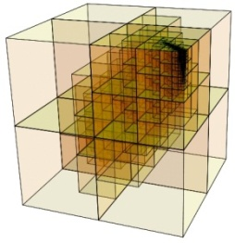
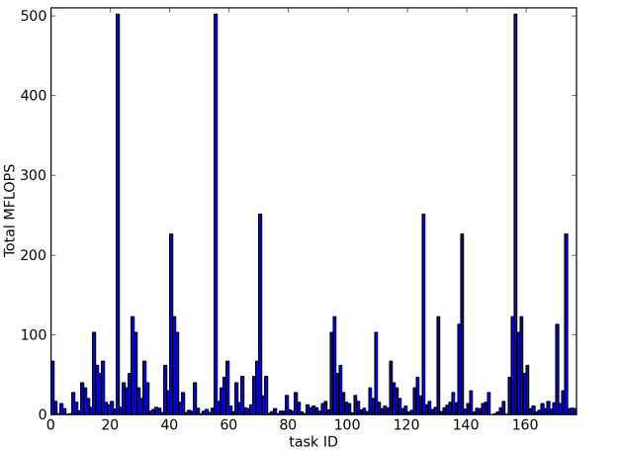
Motivation
Effectively dealing with irregularity in highly parallel applications is difficult.
Sparsity and task variation are inherent to many computational problems.
Load balancing is important, and must be done in a way that preserves effective overlap of communication and computation.
Simply using non-blocking communication calls is not enough for collections of highly irregular tasks.

Slide 4
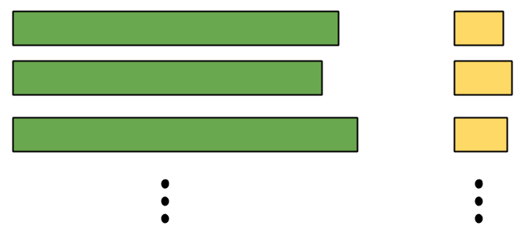
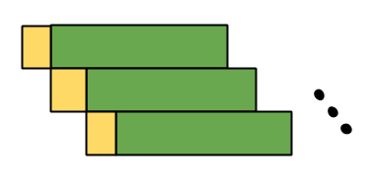
Motivation
}
Overlap each execute_task() with the next get_task()
execute()
get()
program trace
time

Slide 5
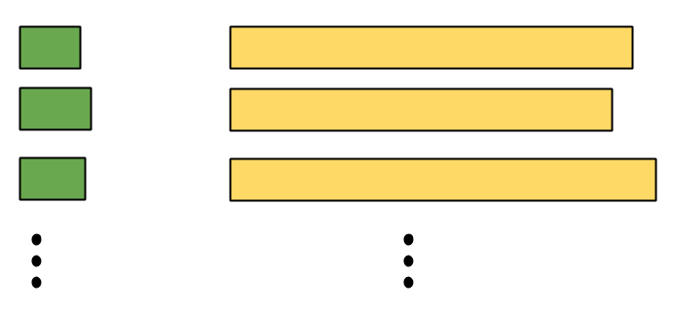
Motivation
}
Overlap each execute_task() with the next get_task()
execute()
get()
program trace
time

Slide 6
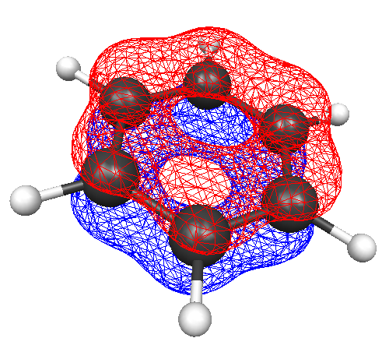
Atomistic and Molecular Simulations
Ab Initio (exact)
Ab Initio (approximate)
Configuration Interaction
Coupled Cluster
Etc.
Hartree-Fock (HF)
Density Functional Theory (DFT)
Etc.
Molecular Dynamics (MD) / Molecular Mechanics (MM)
Nima Nouri, ©2011 GPIUTMD, http://gpiutmd.iut.ac.ir

Slide 7
Atomistic and Molecular Simulations
Ab Initio (exact)
Ab Initio (approximate)
Configuration Interaction
Coupled Cluster
Etc.
Hartree-Fock (HF)
Density Functional Theory (DFT)
Etc.
Molecular Dynamics (MD) / Molecular Mechanics (MM)
Nima Nouri, ©2011 GPIUTMD, http://gpiutmd.iut.ac.ir

Slide 8
Many-body Methods for Electron Correlation
Goal: to accurately solve the Schrödinger equation
must incorporate the instantaneous interactions of multiple electrons.
has been computationally intractable for > 50 years
Important for understanding and predicting:
dipole moments
polarizability
understanding spectra
determining accurate equilibrium geometries/energies
Now made possible by powerful supercomputers
Coupled Cluster technique: most promising
Notes:
Important for:
* Dipole moment, polarizability,…
* Spectra: electronic, photoelectron,vibrational, rotational, NMR, …
* Equilibrium geometry is one with minimum energy

Slide 9
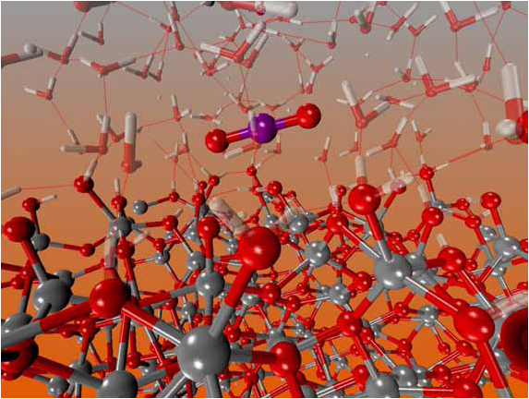
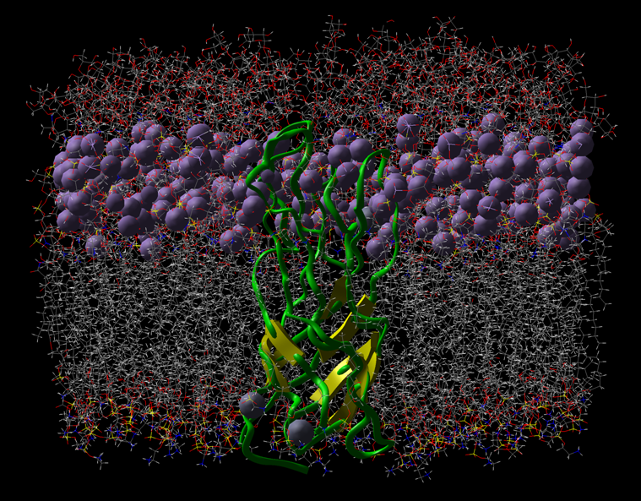
NWChem and Coupled Cluster
NWChem:
Wide range of methods, accuracies, and supported supercomputer architectures
Well-known for its support of many quantum mechanical methods on massively parallel systems.
Built on top of Global Arrays (GA) and ARMCI
Coupled Cluster (CC):
Ab initio - i.e., Highly accurate
Solves an Schrödinger Eqn. ansatz
Accuracy hierarchy:
CCSD < CCSD(T) < CCSDT < CCSDT(Q) < CCSDTQ
The respective computational costs:
And respective storage costs:
Notes:
One of the very few codes that are used at petascale

Slide 10
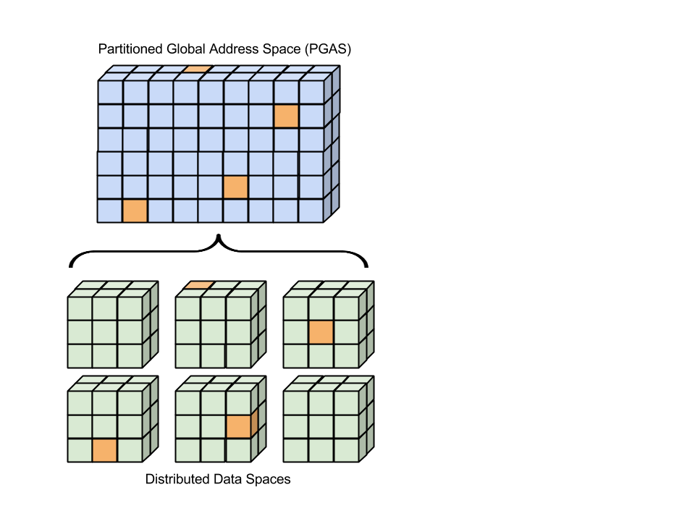
NWChem and Coupled Cluster
Coupled Cluster (CC):
Ab initio - Highly accurate
Accuracy hierarchy:
CCSD < CCSD(T) < CCSDT < CCSDTQ
Computational/Memory scaling:

Slide 11
NWChem and Coupled Cluster

Slide 12
NWChem and Coupled Cluster
NWChem:
Wide range of methods, accuracies, and supported supercomputer architectures
Well-known for its support of many quantum mechanical methods on massively parallel systems.
Built on top of Global Arrays (GA) and ARMCI
Coupled Cluster (CC):
Ab initio - i.e., Highly accurate
Solves an Schrödinger Eqn. ansatz
Accuracy hierarchy:
CCSD < CCSD(T) < CCSDT < CCSDT(Q) < CCSDTQ
The respective computational costs:
And respective storage costs:

Slide 13
NWChem and Coupled Cluster
NWChem:
Wide range of methods, accuracies, and supported supercomputer architectures
Well-known for its support of many quantum mechanical methods on massively parallel systems.
Built on top of Global Arrays (GA) and ARMCI
Coupled Cluster (CC):
Ab initio - i.e., Highly accurate
Solves an Schrödinger Eqn. ansatz
Accuracy hierarchy:
CCSD < CCSD(T) < CCSDT < CCSDT(Q) < CCSDTQ
The respective computational costs:
And respective storage costs:

Slide 14
Sparsity and Load Imbalance
=
*
=
*
TILING
?
=
*
=
*
Load balance is crucially important for performance
Obtaining optimal load balance is NP-Hard

Slide 15
Previous Work:
Inspector/Executor Load Balancing

Slide 16
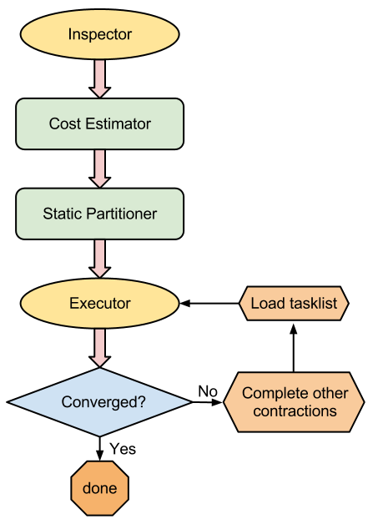
I/E Static Partitioning Design
Inspector
Calculate memory requirements
Detect null tasks
Collate task-list
Task Cost Estimator
Two options:
Use performance models
Timers from previous iteration(s)
Static Partitioner
Partition into N groups where N is the number of MPI processes
Minimize load balance according to cost estimations
Write task list information for each process to volatile memory
Executor
Launch all tasks

Slide 17
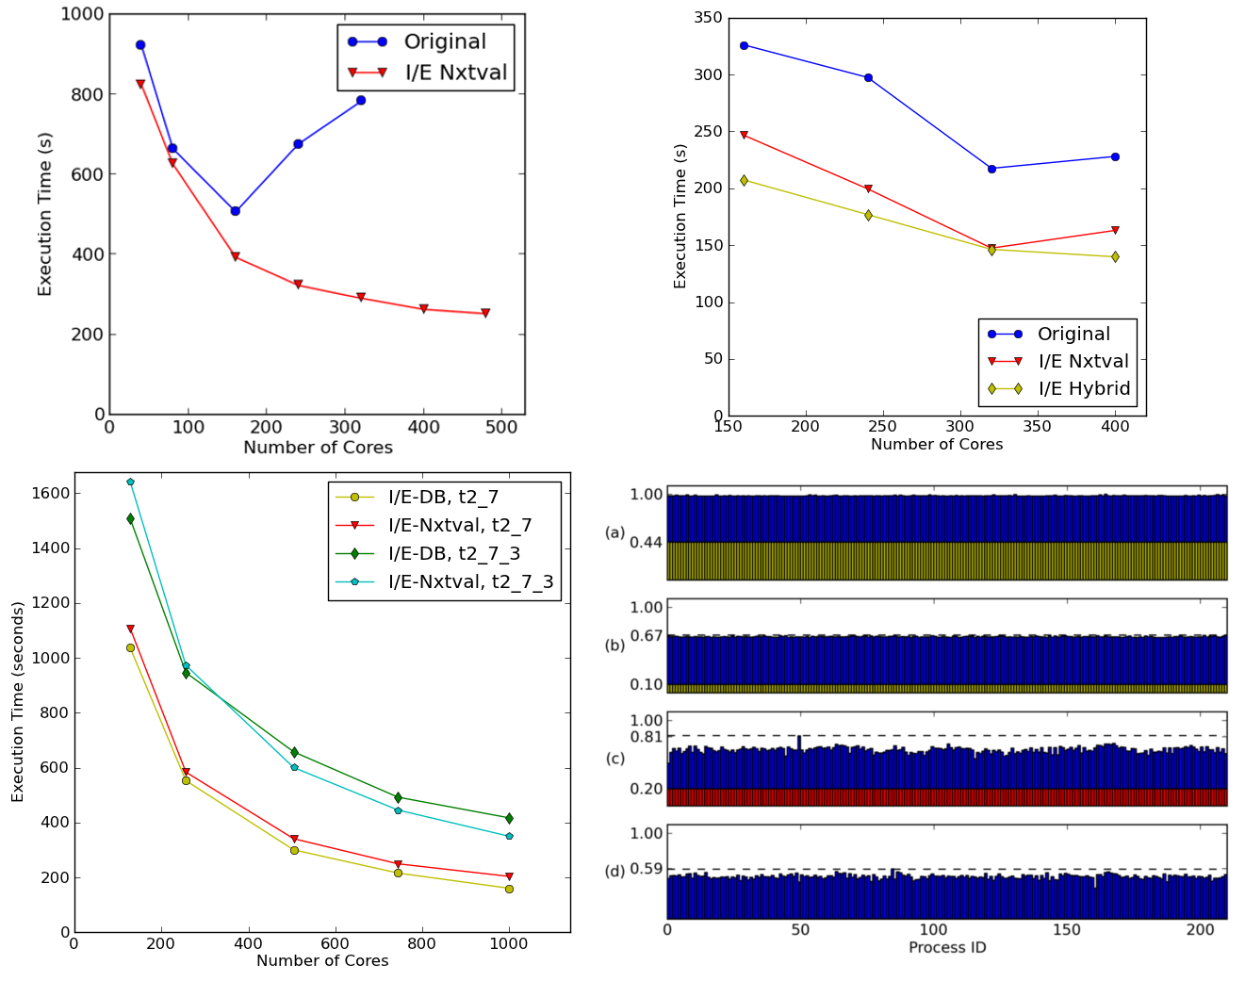
I/E Results
Nitrogen
Benzene
10 water molecules

Slide 18
I/E Results
Nitrogen
Benzene
10 water molecules

Slide 19
Tensor Contraction Engine (TCE)
Example of an expanded term:
A Python-based DSL that automatically generates GA/Fortran routines.
Automates the derivation and parallelization of CC equations.
Each tensor contraction consists of many 2D matrix multiplications (BLAS – Level 3).
My optimizations are done manually, with intent to incorporate into TCE.
hbar[a,b,i,j] == sum[f[b,c] * t[i,j,a,c], c] - sum[f[k,c] * t[k,b] * t[i,j,a,c], k,c] + sum[f[a,c] * t[i,j,c,b], c] - sum[f[k,c] * t[k,a] * t[i,j,c,b], k,c] - sum[f[k,j] * t[i,k,a,b], k] - sum[f[k,c] * t[j,c] * t[i,k,a,b], k,c] - sum[f[k,i] * t[j,k,b,a] , k] - sum[f[k,c] * t[i,c] * t[j,k,b,a], k,c] + sum[t[i,c] * t[j,d] * v[a,b,c,d], c,d] + sum[t[i,j,c,d] * v[a,b,c,d], c,d] + sum[t[j,c] * v[a,b,i,c], c] - sum[t[k,b] * v[a,k,i,j] , k] + sum[t[i,c] * v[b,a,j,c], c] - sum[t[k,a] * v[b,k,j,i], k] - sum[t[k,d] * t[i,j,c,b] * v[k,a,c,d], k,c,d] - sum[t[i,c] * t[j,k,b,d] * v[k,a,c,d], k,c,d] - sum[t[j,c] * t[k,b] * v[k,a,c,i], k,c] + 2 * sum[t[j,k,b,c] * v[k,a,c,i], k,c] - sum[t[j,k,c,b] * v[k,a,c,i] , k,c] - sum[t[i,c] * t[j,d] * t[k,b] * v[k,a,d,c], k,c,d] + 2 * sum[t[k,d] * t[i,j,c,b] * v[k,a,d,c],k,c,d] - sum[t[k,b] * t[i,j,c,d] * v[k,a,d,c], k,c,d] - sum[t[j,d] * t[i,k,c,b] * v[k,a,d,c], k,c,d] + 2 * sum[t[i,c] * t[j,k,b,d] * v[k,a,d,c], k,c,d] - sum[t[i,c] * t[j,k,d,b] * v[k,a,d,c], k,c,d] - sum[t[j,k,b,c] * v[k,a,i,c], k,c] - sum[t[i,c] * t[k,b] * v[k,a,j,c], k,c] - sum[t[i,k,c,b] * v[k,a,j,c], k,c] - sum[t[i,c] * t[j,d] * t[k,a] * v[k,b,c,d], k,c,d] - sum[t[k,d] * t[i,j,a,c] v[k,b,c,d], k,c,d] - sum[t[k,a] * t[i,j,c,d] * v[k,b,c,d], k,c,d] + 2 * sum[t[j,d] * t[i,k,a,c] * v[k,b,c,d], k,c,d] - sum[t[j,d] * t[i,k,c,a] * v[k,b,c,d], k,c,d] - sum[t[i,c] * t[j,k,d,a] * v[k,b,c,d] , k,c,d] - sum[t[i,c] * t[k,a] * v[k,b,c,j], k,c] + 2 * sum[t[i,k,a,c] * v[k,b,c,j] , k,c] - sum[t[i,k,c,a] * v[k,b,c,j], k,c] + 2 * sum[t[k,d] * t[i,j,a,c] * v[k,b,d,c] , k,c,d] - sum[t[j,d] * t[i,k,a,c] * v[k,b,d,c], k,c,d] - sum[t[j,c] * t[k,a] * v[k,b,i,c] , k,c] - sum[t[j,k,c,a] * v[k,b,i,c], k,c] - sum[t[i,k,a,c] * v[k,b,j,c], k,c] + sum[t[i,c] * t[j,d] * t[k,a] * t[l,b] * v[k,l,c,d], k,l,c,d] - 2 * sum[t[k,b] * t[l,d] * t[i,j,a,c] * v[k,l,c,d], k,l,c,d] - 2 * sum[t[k,a] * t[l,d] * t[i,j,c,b] * v[k,l,c,d], k,l,c,d] + sum[t[k,a] * t[l,b] * t[i,j,c,d] * v[k,l,c,d], k,l,c,d] - 2 * sum[t[j,c] * t[l,d] * t[i,k,a,b] * v[k,l,c,d], k,l,c,d] - 2 * sum[t[j,d] * t[l,b] * t[i,k,a,c] * v[k,l,c,d] , k,l,c,d] + sum[t[j,d] * t[l,b] * t[i,k,c,a] * v[k,l,c,d], k,l,c,d] - 2 * sum[t[i,c] * t[l,d] * t[j,k,b,a] * v[k,l,c,d], k,l,c,d] + sum[t[i,c] * t[l,a] * t[j,k,b,d] * v[k,l,c,d] , k,l,c,d] + sum[t[i,c] * t[l,b] * t[j,k,d,a] * v[k,l,c,d], k,l,c,d] + sum[t[i,k,c,d] * t[j,l,b,a] * v[k,l,c,d], k,l,c,d] + 4 * sum[t[i,k,a,c] * t[j,l,b,d] * v[k,l,c,d] , k,l,c,d] - 2 * sum[t[i,k,c,a] * t[j,l,b,d] * v[k,l,c,d], k,l,c,d] - 2 * sum[t[i,k,a,b] * t[j,l,c,d] * v[k,l,c,d], k,l,c,d] - 2 * sum[t[i,k,a,c] * t[j,l,d,b] * v[k,l,c,d] , k,l,c,d] + sum[t[i,k,c,a] * t[j,l,d,b] * v[k,l,c,d], k,l,c,d] + sum[t[i,c] * t[j,d] * t[k,l,a,b] * v[k,l,c,d], k,l,c,d] + sum[t[i,j,c,d] * t[k,l,a,b] * v[k,l,c,d], k,l,c,d] - 2 * sum[t[i,j,c,b] * t[k,l,a,d] * v[k,l,c,d], k,l,c,d] - 2 * sum[t[i,j,a,c] * t[k,l,b,d] * v[k,l,c,d], k,l,c,d] + sum[t[j,c] * t[k,b] * t[l,a] * v[k,l,c,i], k,l,c] + sum[t[l,c] * t[j,k,b,a] * v[k,l,c,i], k,l,c] - 2 * sum[t[l,a] * t[j,k,b,c] * v[k,l,c,i], k,l,c] + sum[t[l,a] * t[j,k,c,b] * v[k,l,c,i], k,l,c] - 2 * sum[t[k,c] * t[j,l,b,a] * v[k,l,c,i] , k,l,c] + sum[t[k,a] * t[j,l,b,c] * v[k,l,c,i], k,l,c]+ sum[t[k,b] * t[j,l,c,a] * v[k,l,c,i] , k,l,c] + sum[t[j,c] * t[l,k,a,b] * v[k,l,c,i], k,l,c] + sum[t[i,c] * t[k,a] * t[l,b] * v[k,l,c,j], k,l,c] + sum[t[l,c] * t[i,k,a,b] * v[k,l,c,j], k,l,c] - 2 * sum[t[l,b] * t[i,k,a,c] * v[k,l,c,j], k,l,c] + sum[t[l,b] * t[i,k,c,a] * v[k,l,c,j], k,l,c] + sum[t[i,c] * t[k,l,a,b] * v[k,l,c,j], k,l,c] + sum[t[j,c] * t[l,d] * t[i,k,a,b] * v[k,l,d,c] , k,l,c,d] + sum[t[j,d] * t[l,b] * t[i,k,a,c] * v[k,l,d,c], k,l,c,d] + sum[t[j,d] * t[l,a] * t[i,k,c,b] * v[k,l,d,c], k,l,c,d] - 2 * sum[t[i,k,c,d] * t[j,l,b,a] * v[k,l,d,c] , k,l,c,d] - 2 * sum[t[i,k,a,c] * t[j,l,b,d] * v[k,l,d,c], k,l,c,d] + sum[t[i,k,c,a] * t[j,l,b,d] * v[k,l,d,c], k,l,c,d] + sum[t[i,k,a,b] * t[j,l,c,d] * v[k,l,d,c], k,l,c,d] + sum[t[i,k,c,b] * t[j,l,d,a] * v[k,l,d,c], k,l,c,d] + sum[t[i,k,a,c] * t[j,l,d,b] * v[k,l,d,c], k,l,c,d] + sum[t[k,a] * t[l,b] * v[k,l,i,j], k,l] + sum[t[k,l,a,b] * v[k,l,i,j] , k,l] + sum[t[k,b] * t[l,d] * t[i,j,a,c] * v[l,k,c,d], k,l,c,d] + sum[t[k,a] * t[l,d] * t[i,j,c,b] * v[l,k,c,d], k,l,c,d] + sum[t[i,c] * t[l,d] * t[j,k,b,a] * v[l,k,c,d] , k,l,c,d] - 2 * sum[t[i,c] * t[l,a] * t[j,k,b,d] * v[l,k,c,d], k,l,c,d] + sum[t[i,c] * t[l,a] * t[j,k,d,b] * v[l,k,c,d], k,l,c,d] + sum[t[i,j,c,b] * t[k,l,a,d] * v[l,k,c,d] , k,l,c,d] + sum[t[i,j,a,c] * t[k,l,b,d] * v[l,k,c,d], k,l,c,d] - 2 * sum[t[l,c] * t[i,k,a,b] * v[l,k,c,j], k,l,c] + sum[t[l,b] * t[i,k,a,c] * v[l,k,c,j], k,l,c] + sum[t[l,a] * t[i,k,c,b] * v[l,k,c,j], k,l,c]

Slide 20
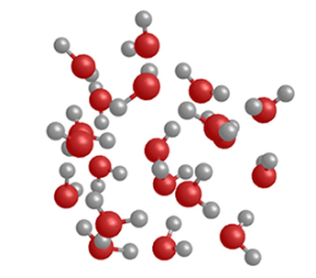
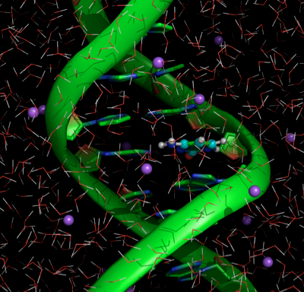
Computational Challenges
Benzene
Water Clusters
Macro-Molecules
Highly symmetric
Asymmetric
QM/MM
Load balance is crucially important for performance
Obtaining optimal load balance is an NP-Hard problem.
Notes:
* Recent publication in International Conference on Advances in Biomedical engineering suggests need for ab initio simultaions of macro-molecules

Slide 21
Design and Implementation: WorkQ Execution Model

Slide 22
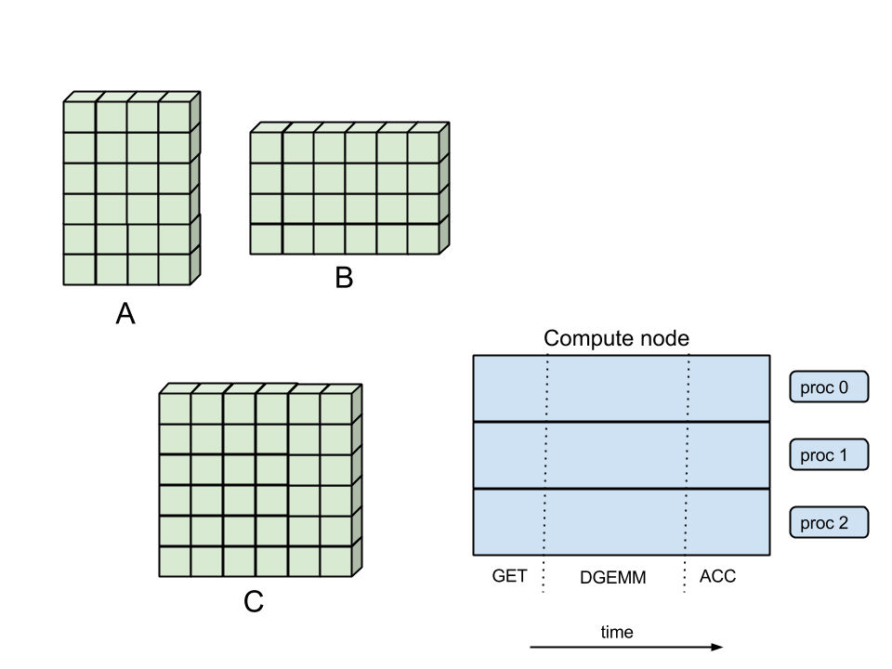
Original Execution

Slide 23
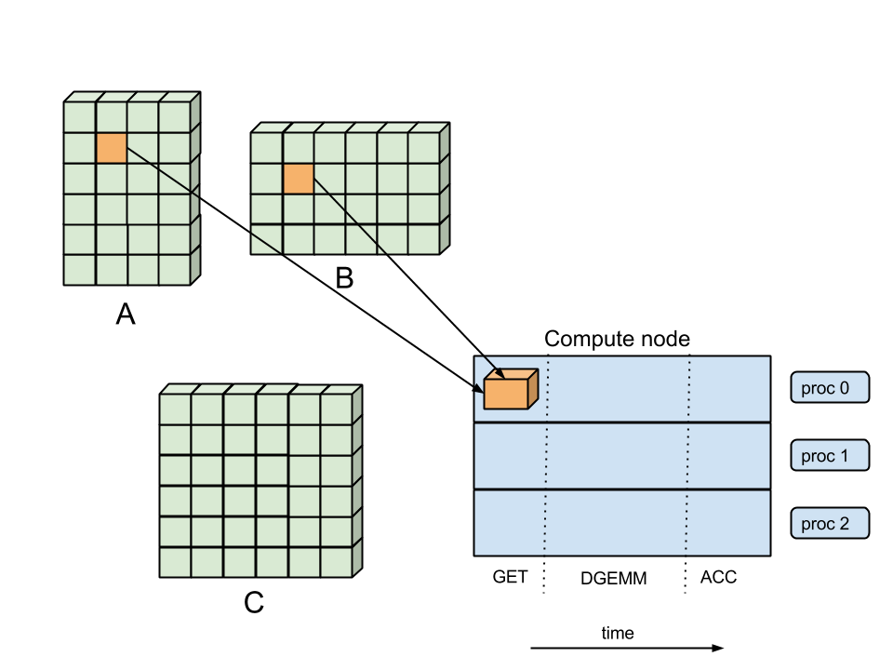
Original Execution

Slide 24
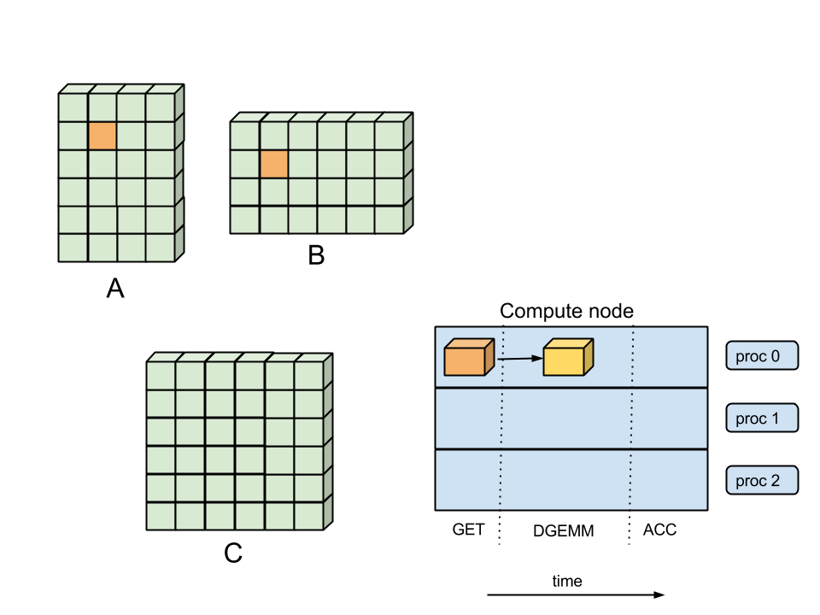
Original Execution

Slide 25
Original Execution

Slide 26
Original Execution

Slide 27
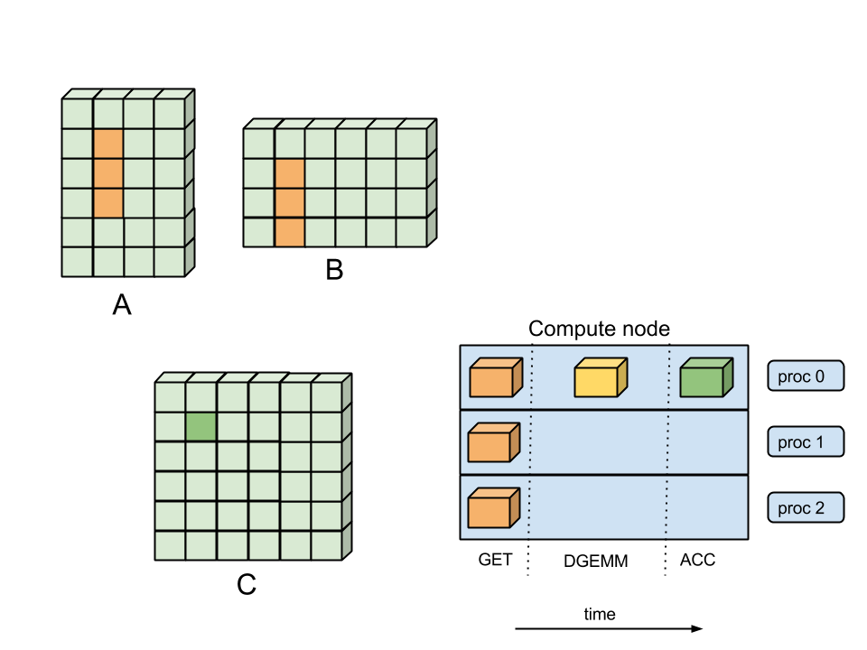
Original Execution

Slide 28
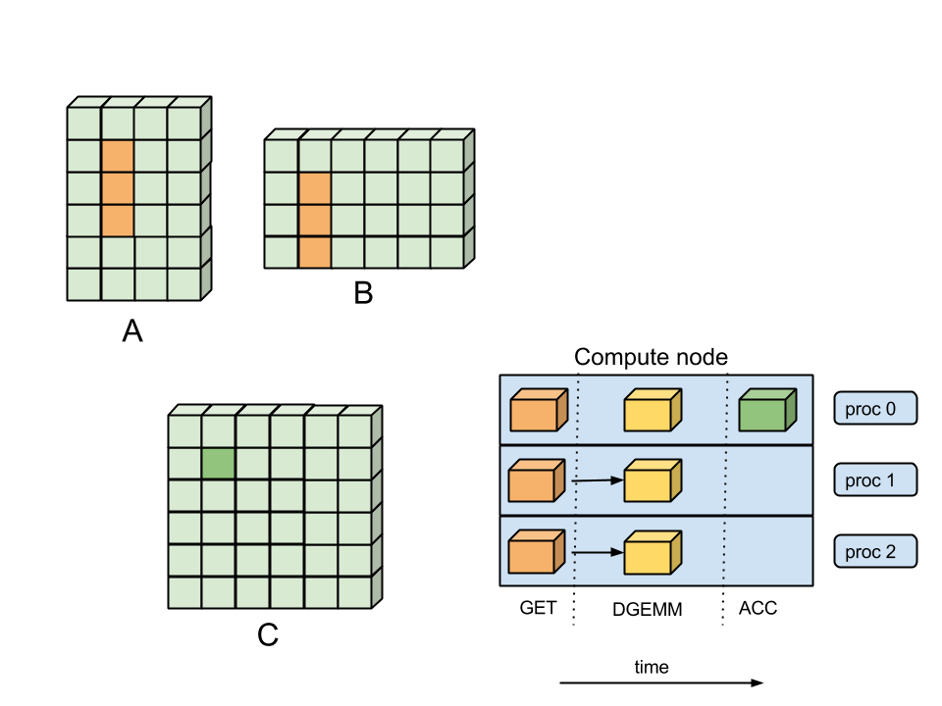
Original Execution

Slide 29
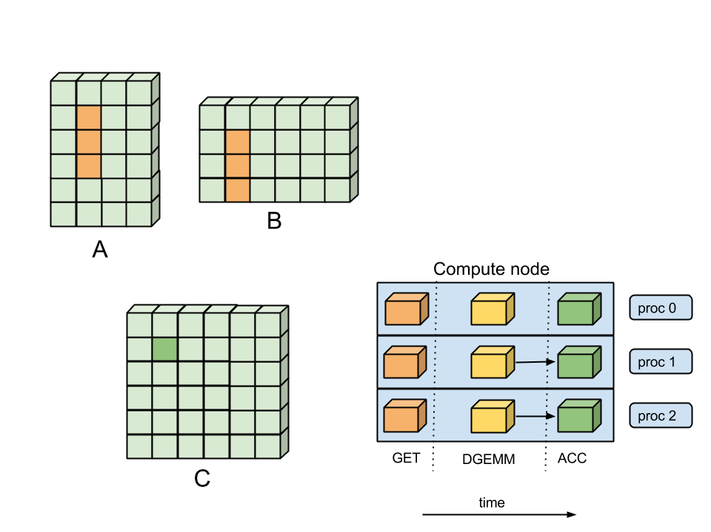
Original Execution

Slide 30
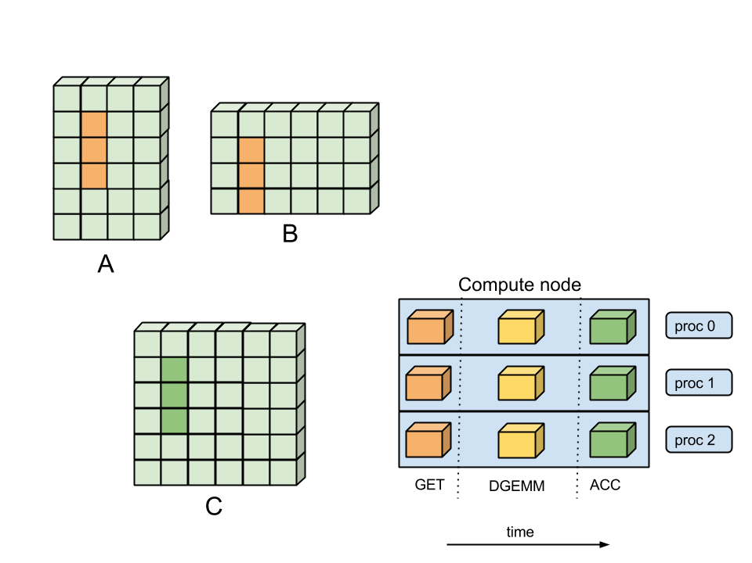
Original Execution

Slide 31
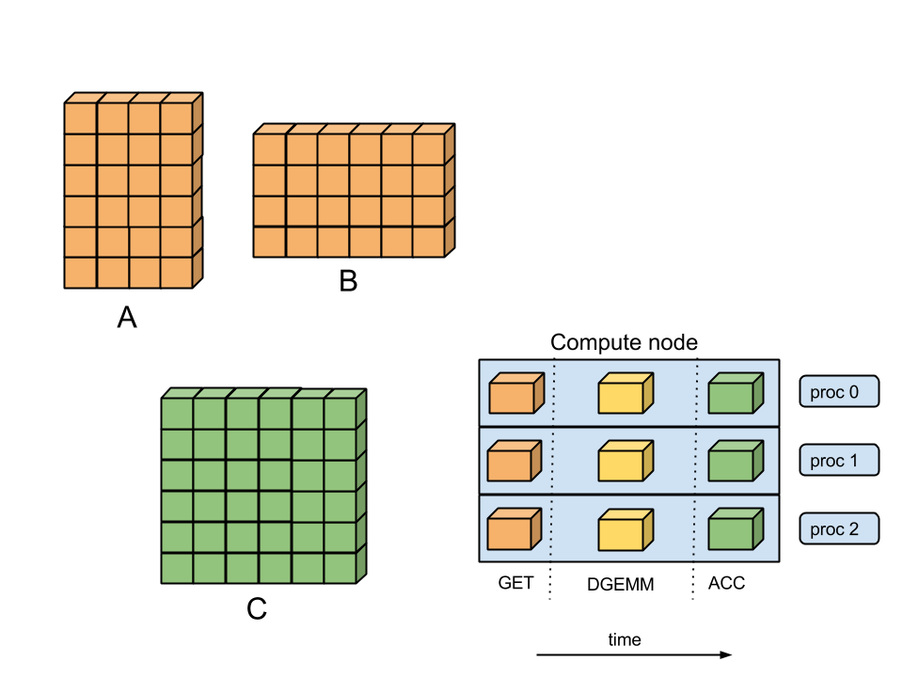
Original Execution

Slide 32
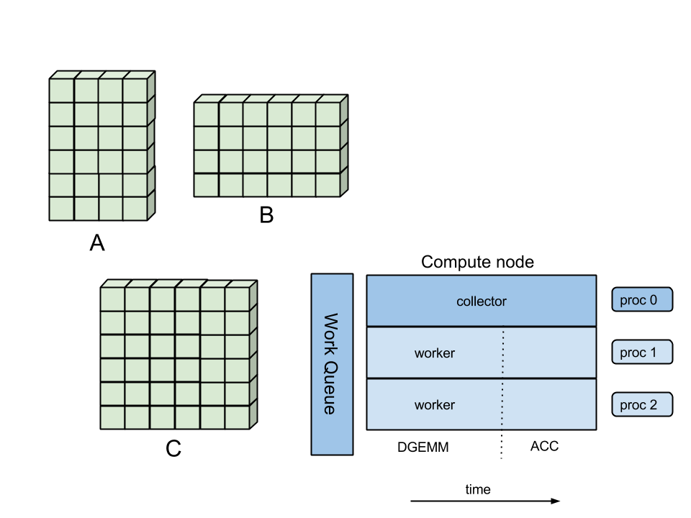
WorkQ Execution

Slide 33
WorkQ Execution

Slide 34
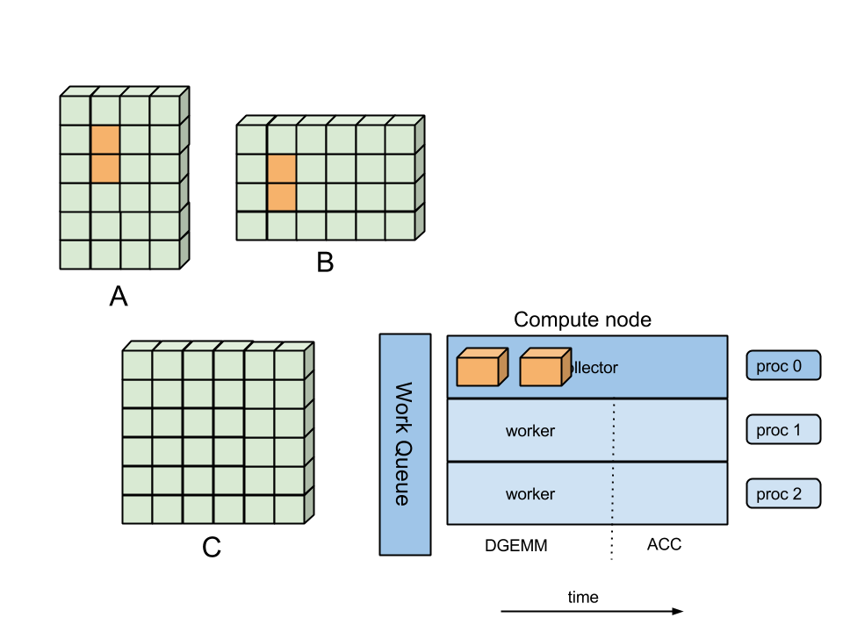
WorkQ Execution

Slide 35
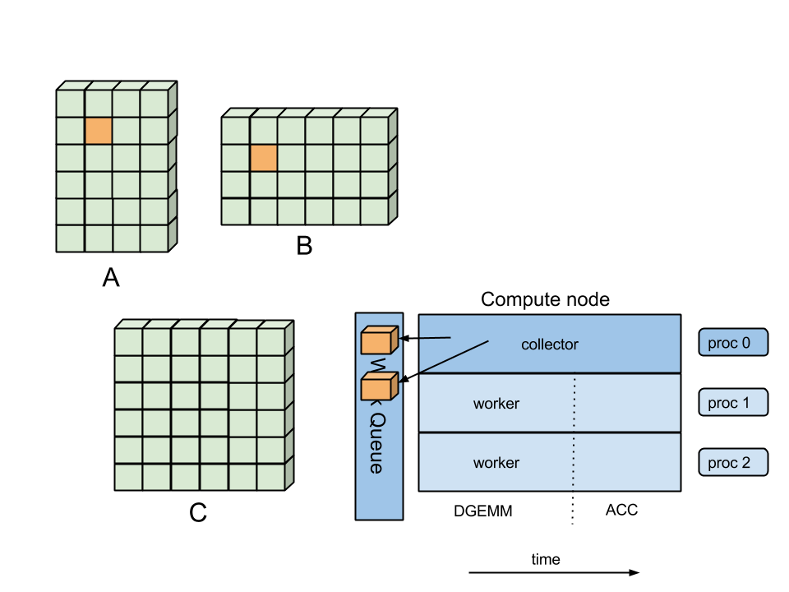
WorkQ Execution

Slide 36
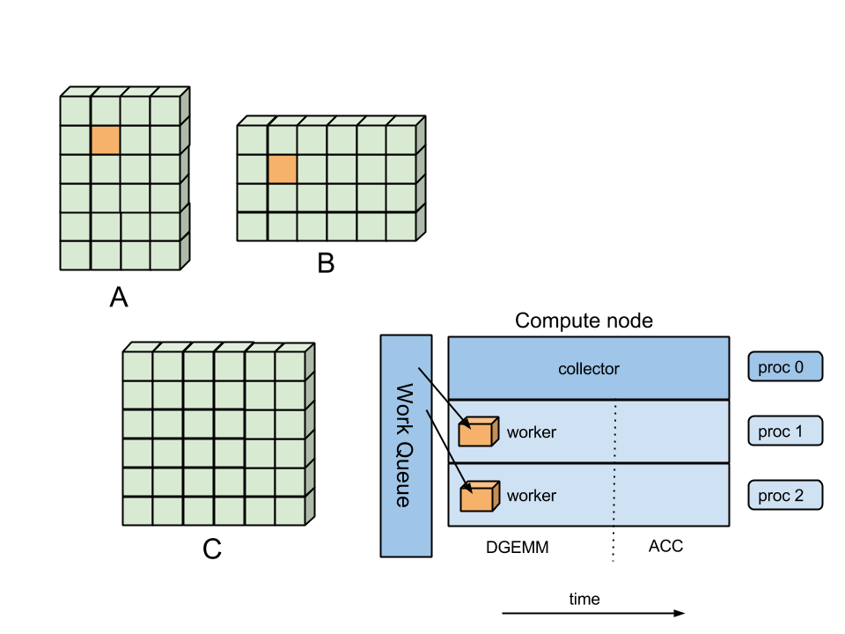
WorkQ Execution

Slide 37
WorkQ Execution

Slide 38
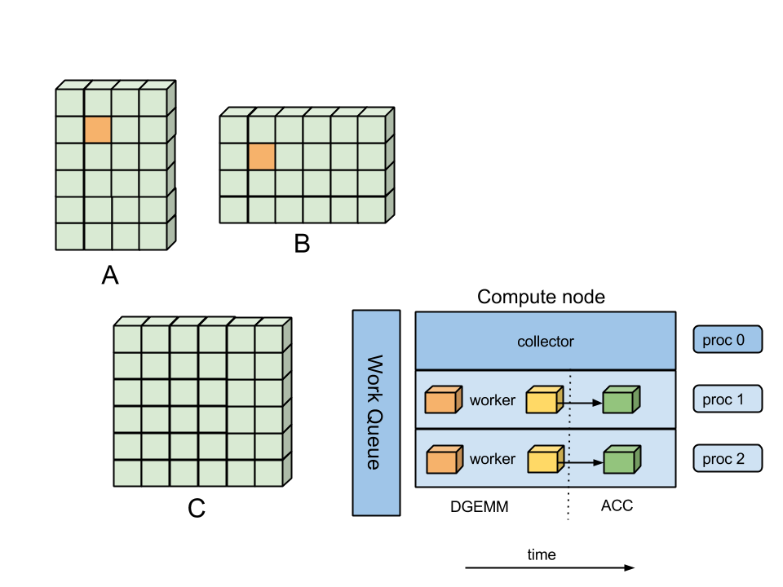
WorkQ Execution

Slide 39
WorkQ Execution

Slide 40
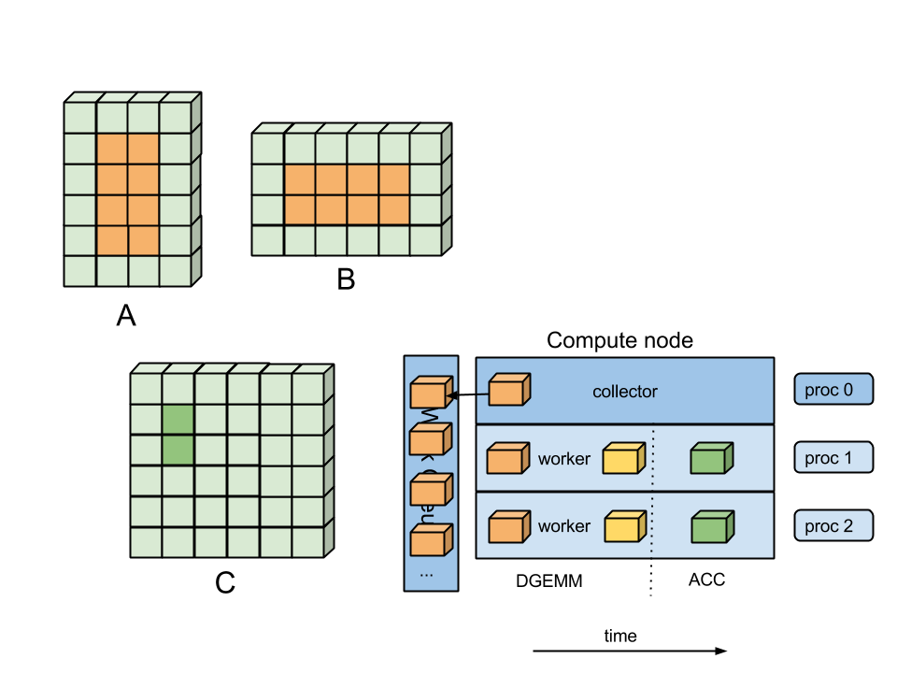
WorkQ Execution

Slide 41
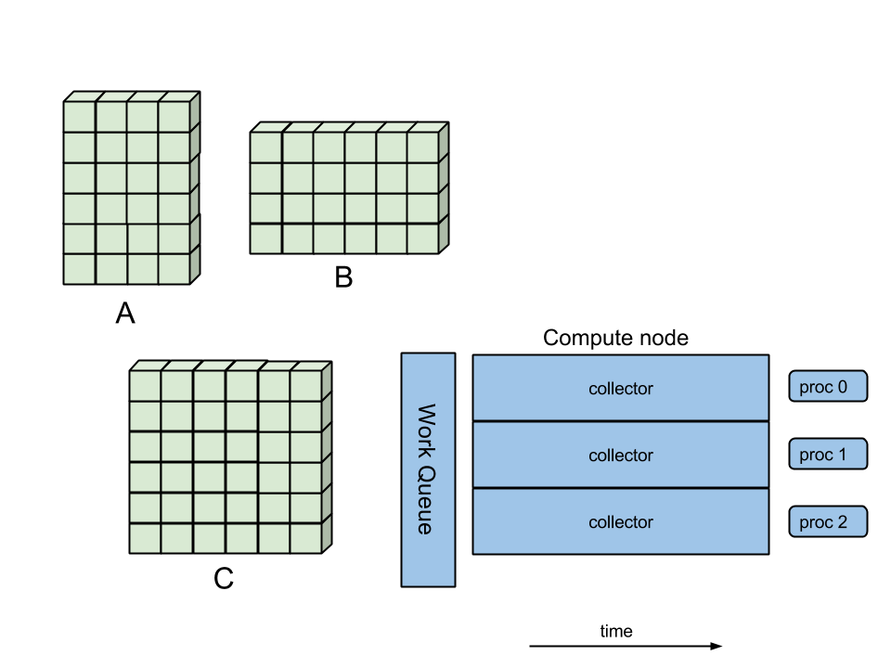
WorkQ Execution

Slide 42
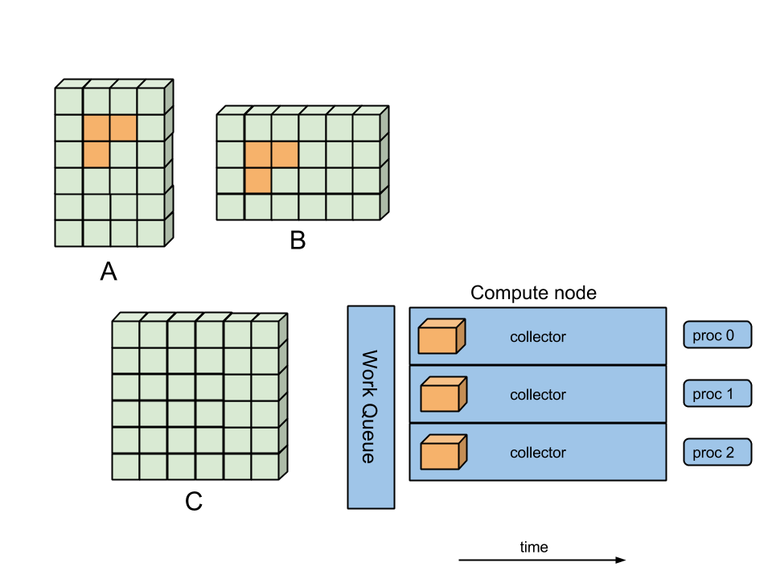
WorkQ Execution

Slide 43
WorkQ Execution

Slide 44
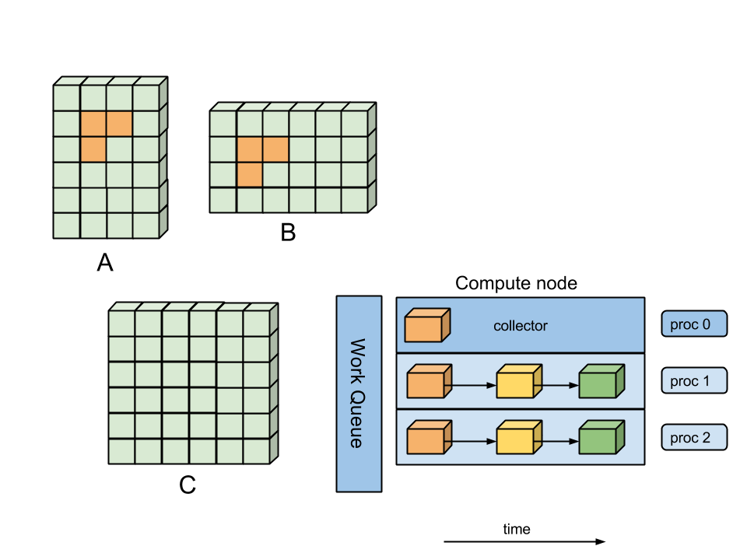
WorkQ Execution

Slide 45
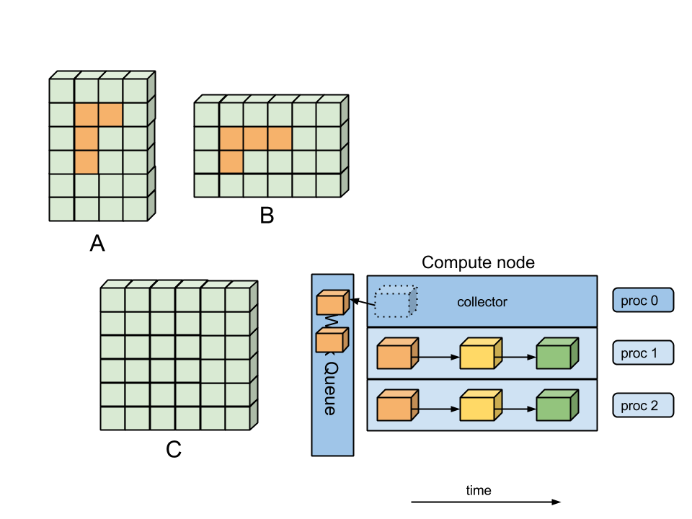
WorkQ Execution

Slide 46
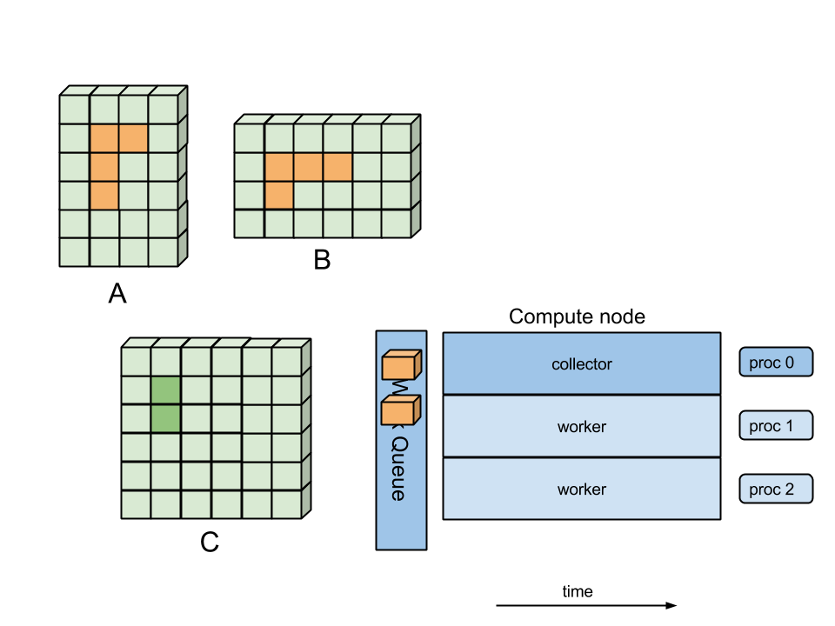
WorkQ Execution

Slide 47
WorkQ Execution

Slide 48
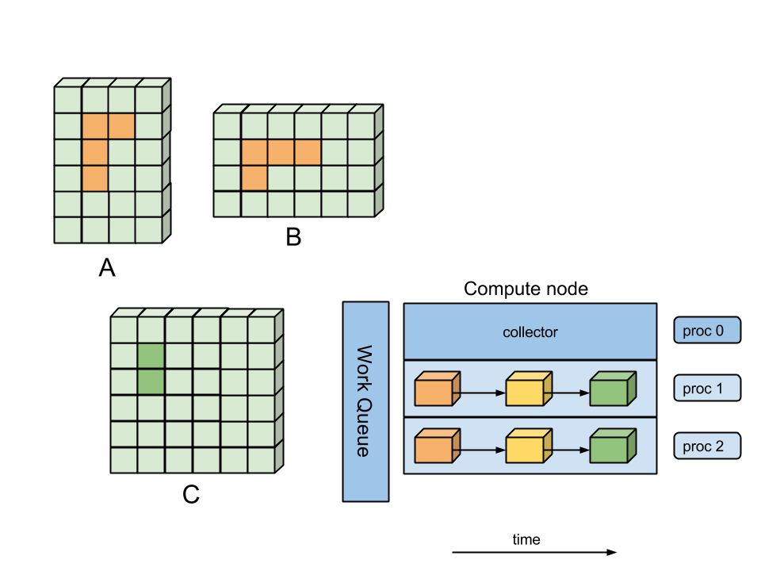
WorkQ Execution

Slide 49
WorkQ Execution

Slide 50
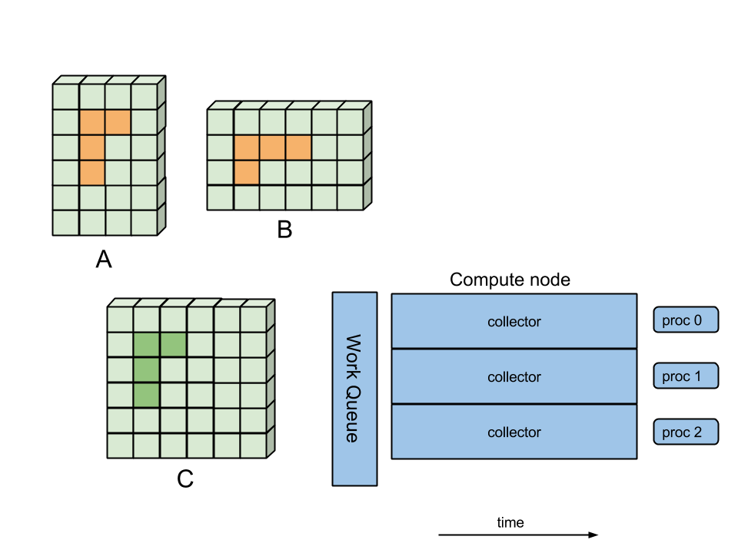
WorkQ Execution

Slide 51
WorkQ Execution

Slide 52
WorkQ Execution

Slide 53
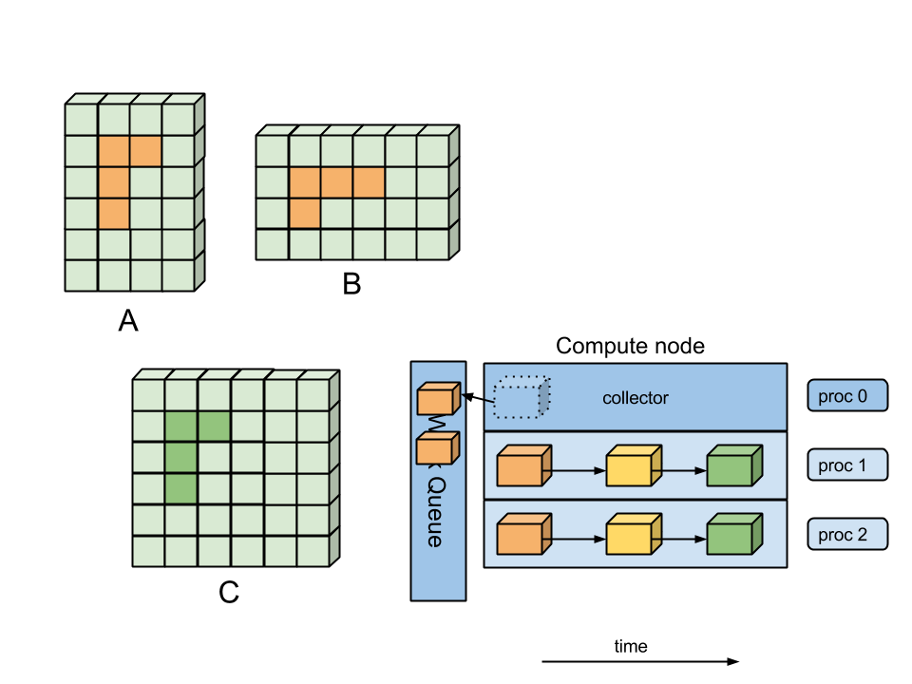
WorkQ Execution

Slide 54
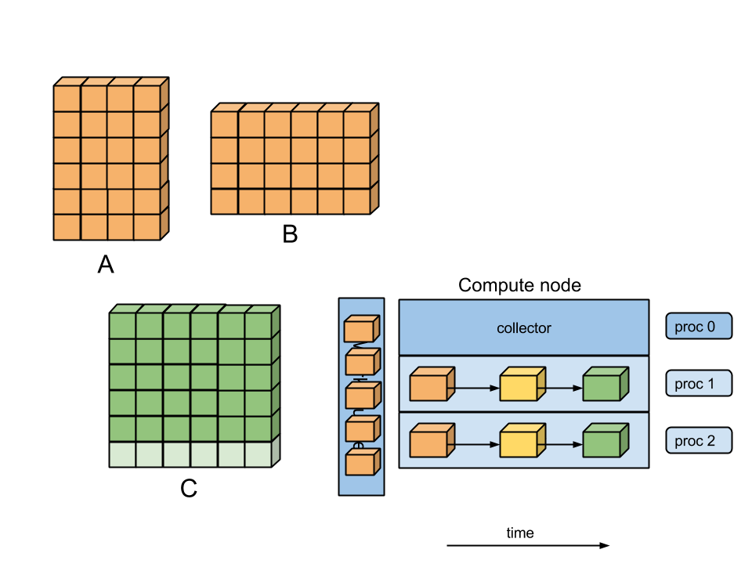
WorkQ Execution

Slide 55
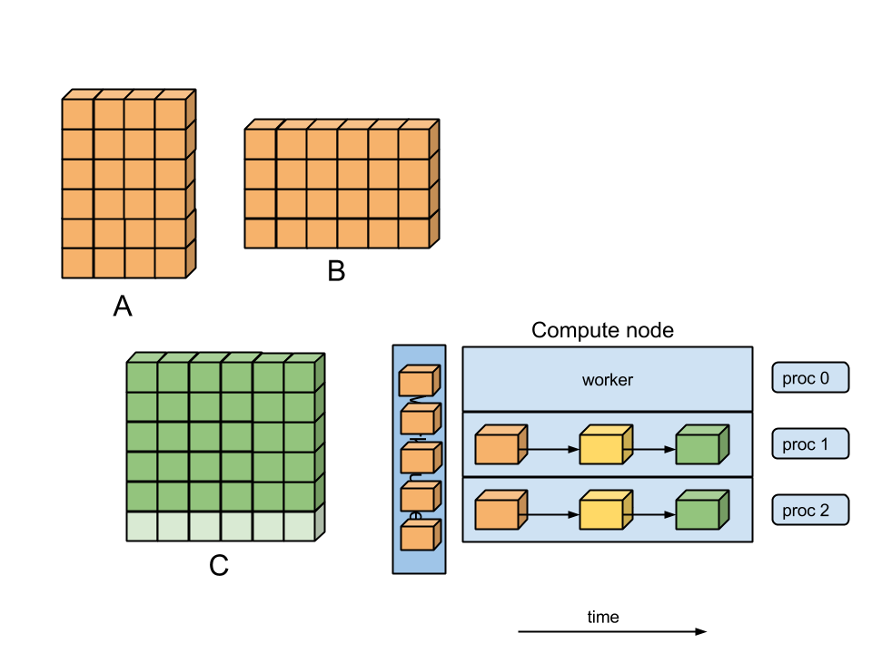
WorkQ Execution

Slide 56
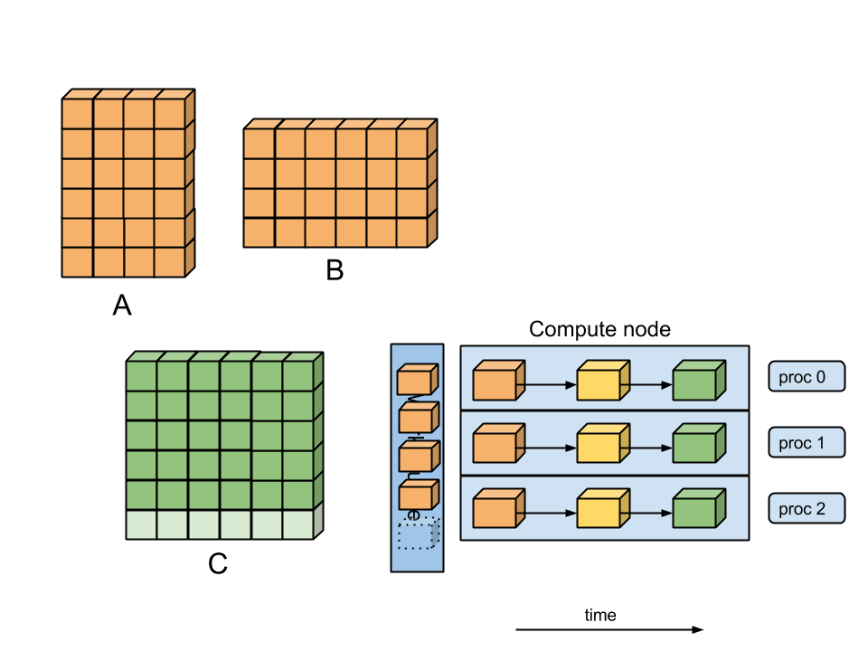
WorkQ Execution

Slide 57
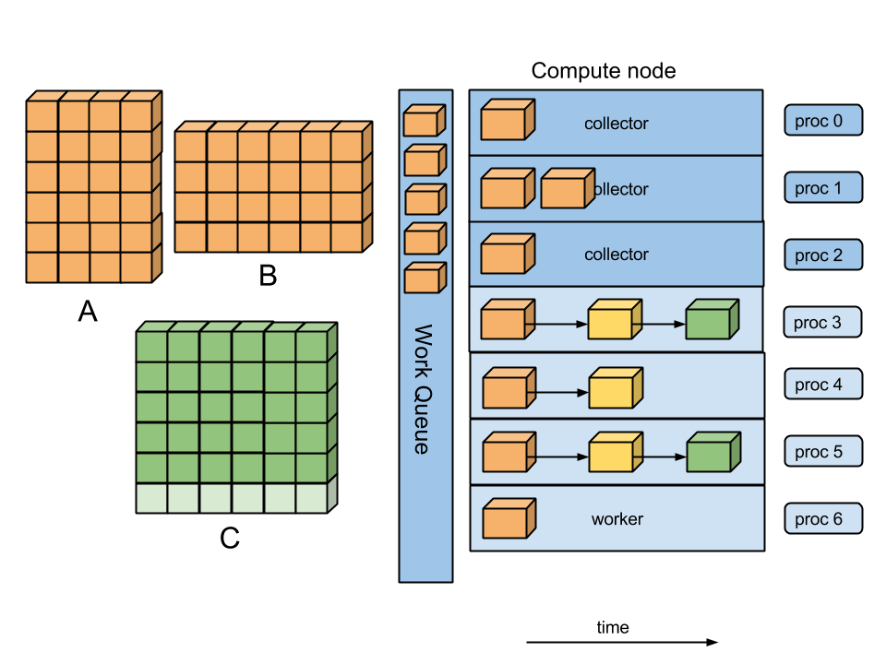
WorkQ Execution

Slide 58
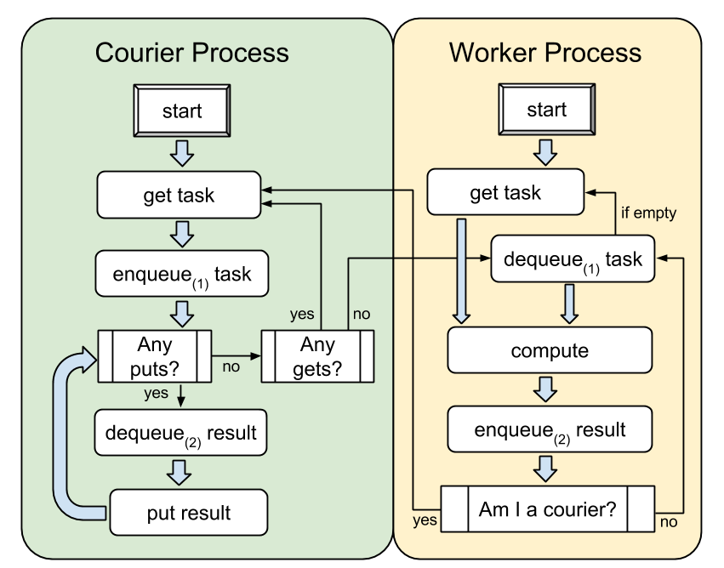
WorkQ Algorithm

Slide 59
WorkQ Library API
Courier:
workq_create_queue()
workq_alloc_task()
workq_append_task()
workq_enqueue()
Worker:
workq_dequeue()
workq_get_next()
workq_execute_task()
Finalization:
workq_free_shm()
workq_destroy()

Slide 60
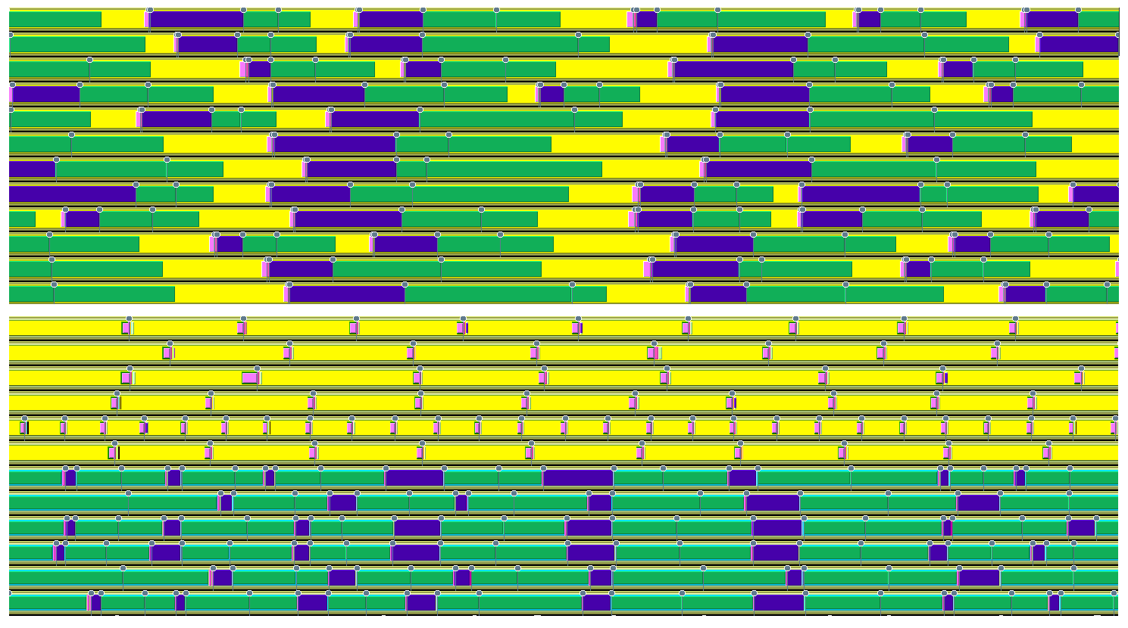
WorkQ Results
Time:
22.1 s
11.5 s
{
{
Original Execution
WorkQ
Execution
time
ARMCI_Rmw()
ARMCI_GetS()
Misc. Computation
DGEMM
(NxtVal)
(Get)
(memory -intensive)
(flop-intensive)

Slide 61
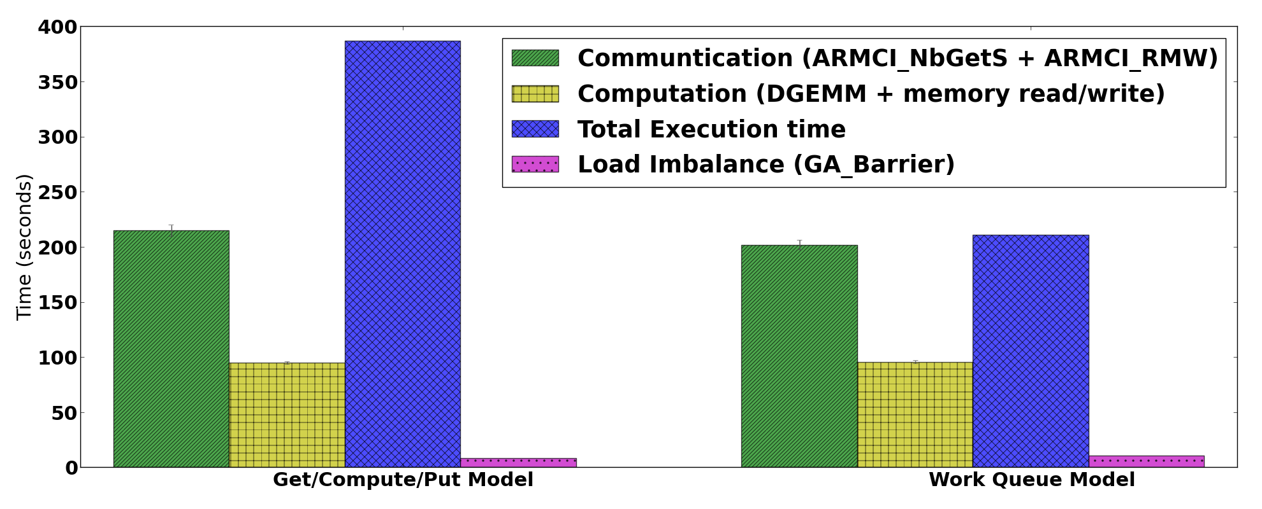
WorkQ Results
(ACISS Cluster at UOregon):

Slide 62
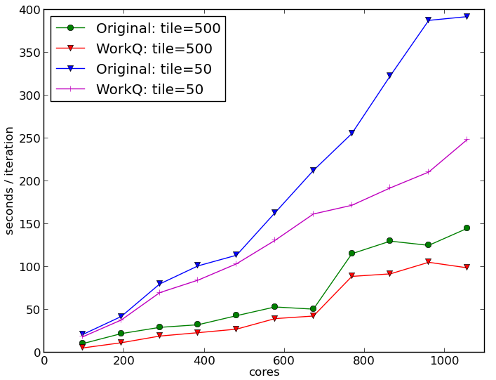
WorkQ Mini-app
Weak Scaling
ACISS Cluster (UOregon):
2x Intel X5650
2.67 GHz 6-core CPUs
12 cores per node
72 GB RAM per node
Ethernet interconnect

Slide 63
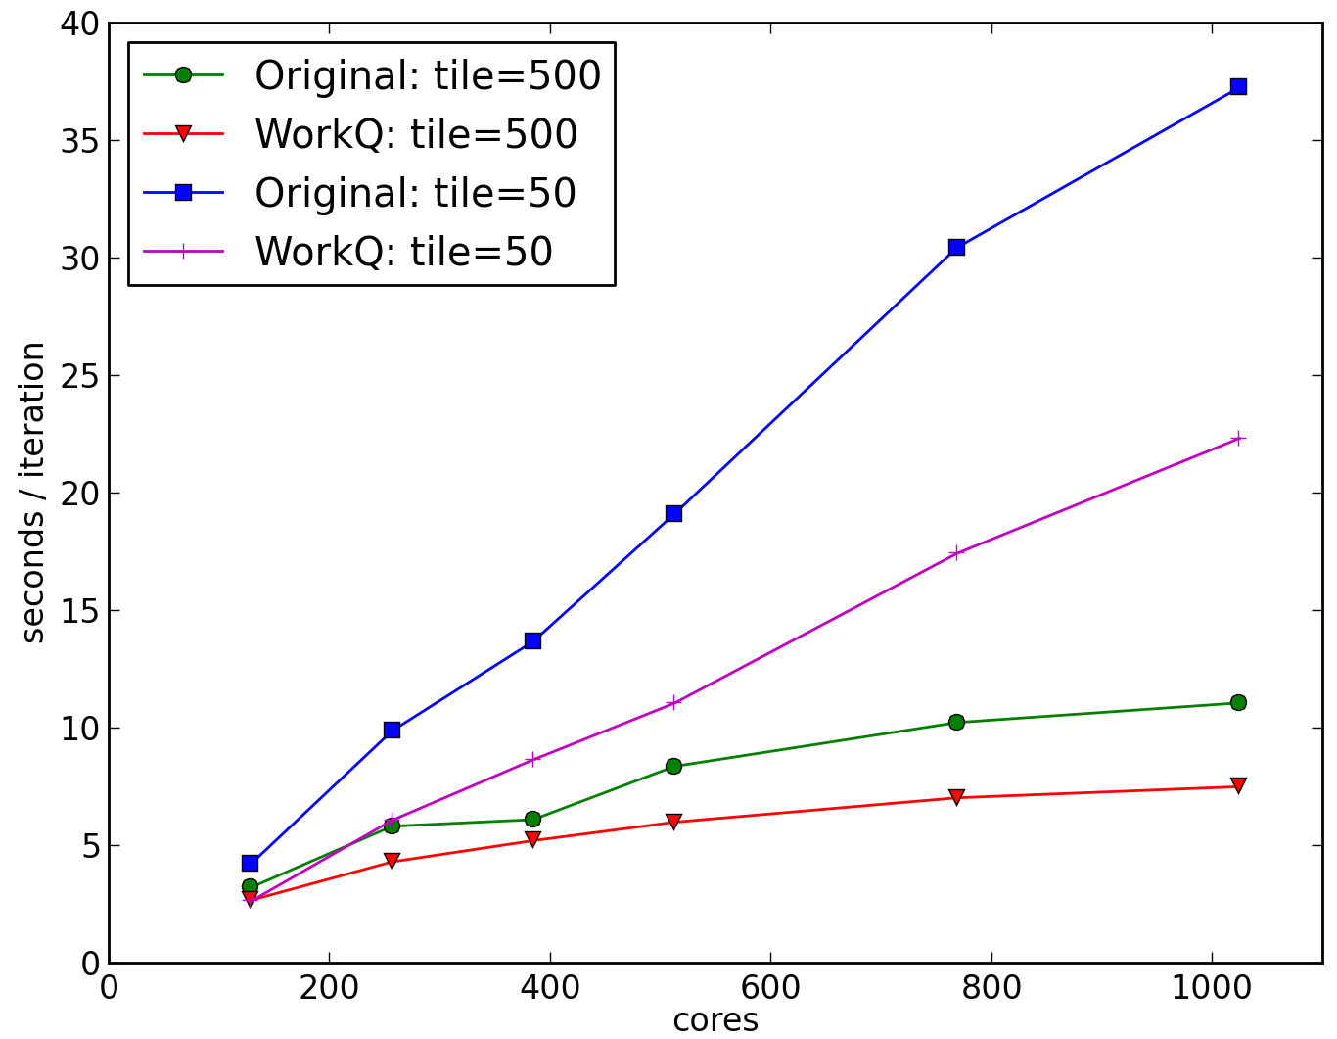
WorkQ Mini-app
Weak Scaling
Blues Cluster (Argonne):
2x Intel X5550
2.67 GHz 4-core CPUs
8 cores per node
24 GB RAM per node
InfiniBand QDR interconnect

Slide 64
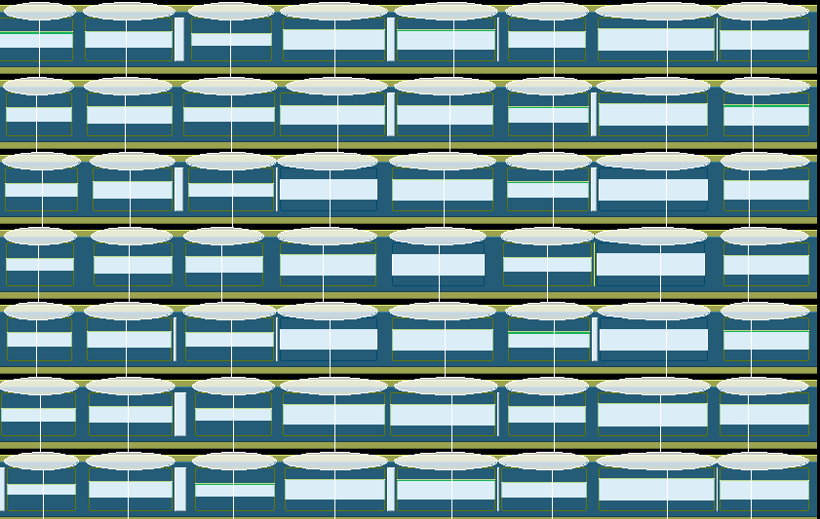
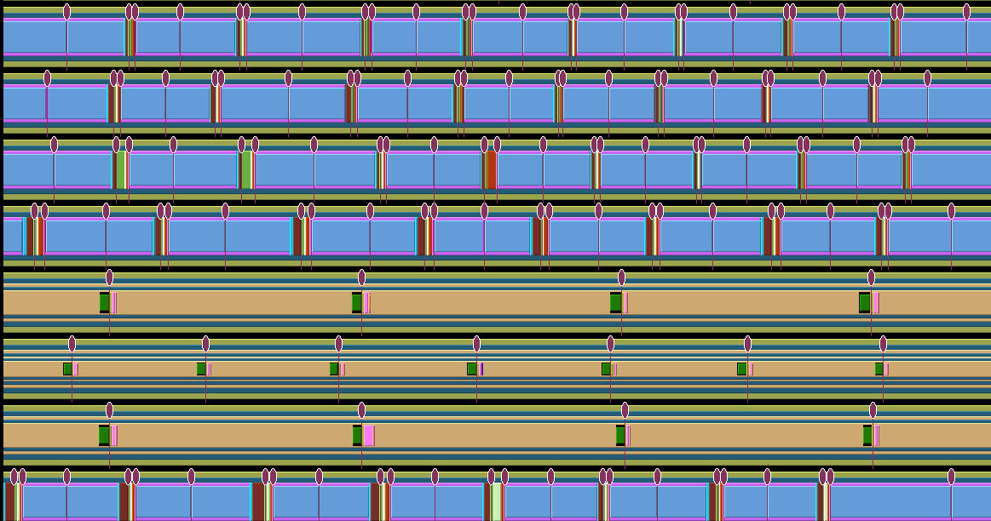
WorkQ Mini-app
Weak Scaling
Original
WorkQ

Slide 65
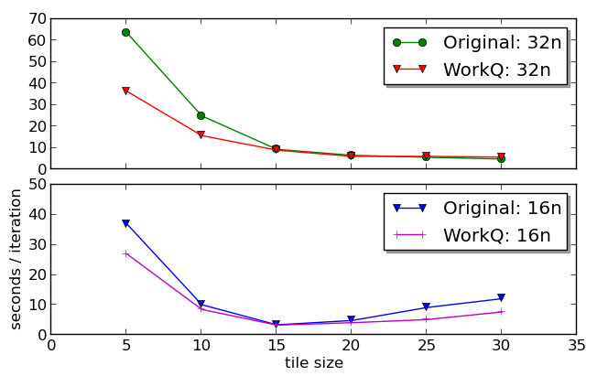
WorkQ w/ NWChem
Experiment
Configuration:
ACISS cluster
3 water molecules
aug-cc-pVDZ basis
Top:
384 MPI processes
Bottom:
192 MPI processes

Slide 66
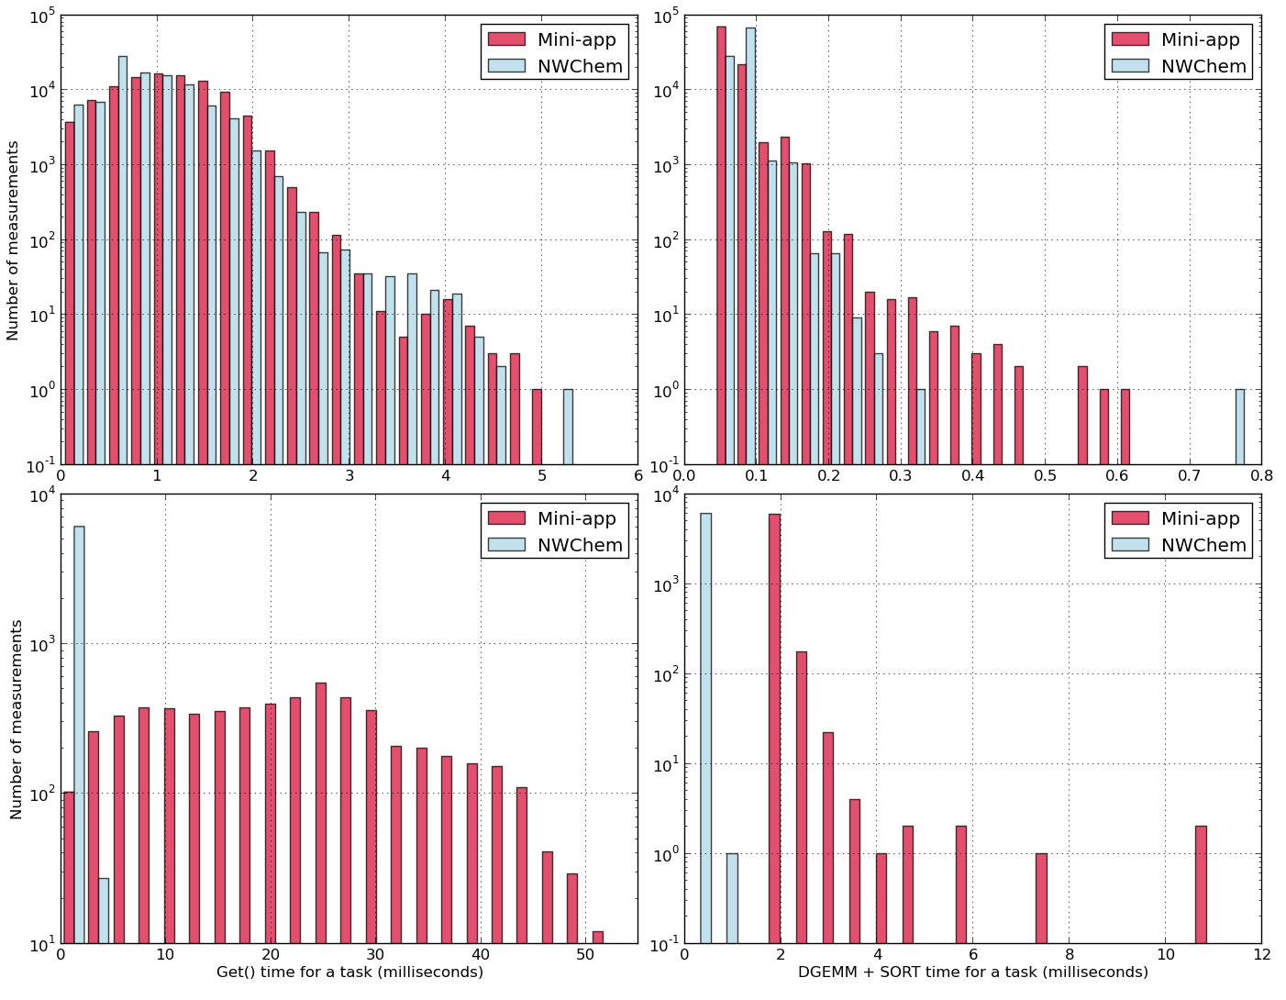
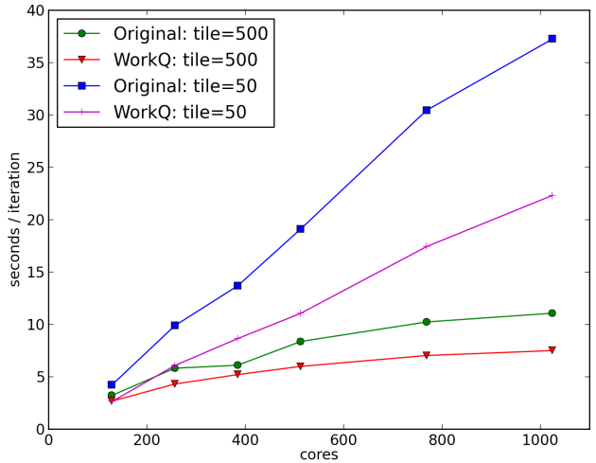
WorkQ w/ NWChem
Experiment
Configuration:
Carver cluster
InfiniBand network
5 water molecules
aug-cc-pVDZ basis
384 MPI processes

Slide 67
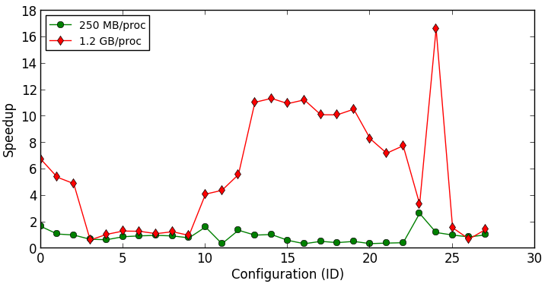
WorkQ Auto-Tuning
Tunable Parameters:
Processes per node
Couriers per node
Tile size
Min queue length
Max queue length
ACISS / Mini-App

Slide 68
Conclusions
The get/compute/put model suffers from unnecessary wait times.
Using non-blocking communication may not achieve optimal overlap with irregular workloads.
Opportunities exist for exploiting communication/computation overlap via a more dynamic and adaptive runtime execution model.
Future work will involve integration of I/E load balancing and WorkQ optimizations, runtime parameter auto-tuning, and exploration on heterogeneous systems.
Notes:
Important for:
* Dipole moment, polarizability,…
* Spectra: electronic, photoelectron,vibrational, rotational, NMR, …
* Equilibrium geometry is one with minimum energy

Slide 69
References
M. Valiev, E.J. Bylaska, N. Govind, K. Kowalski, T.P. Straatsma, H.J.J. Van Dam, D. Wang, J. Nieplocha, E. Apra, T.L. Windus, W.A. de Jong, “NWChem: A comprehensive and scalable open-source solution for large scale molecular simulations”, Computer Physics Communications, Volume 181, Issue 9, September 2010, 1477–89.
So Hirata, “Tensor Contraction Engine: Abstraction and Automated Parallel Implementation of Configuration-Interaction, Coupled-Cluster, and Many-Body Perturbation Theories”, The Journal of Physical Chemistry A 2003 107 (46), 9887-9897.
J. Nieplocha, R.J. Harrison, and R.J. Littlefield. Global Arrays: A Nonuniform Memory Access Programming Model for HighPerformance Computers. The Journal of Supercomputing, 10(2):169–189, 1996.
Jarek Nieplocha and Bryan Carpenter. ARMCI: A Portable Remote Memory Copy Library for Distributed Array Libraries and Compiler Run-time Systems. In Parallel and Distributed Processing, volume 1586 of Lecture Notes in Computer Science, pages 533–546. Springer Berlin Heidelberg, 1999.
David Ozog, Jeff Hammond, James Dinan, Pavan Balaji, Sameer Shende, Allen Malony: Inspector-Executor Load Balancing Algorithms for Block-Sparse Tensor Contractions. ICPP 2013.

