Slide 1
Efficient Intranode Communication in GPU-Accelerated Systems
Feng Ji, Ashwin M. Aji, James Dinan, Darius Buntinas,
Pavan Balaji, Wu-chun Feng, Xiaosong Ma
Presented by: James Dinan
James Wallace Givens Postdoctoral Fellow
Argonne National Laboratory

Slide 2
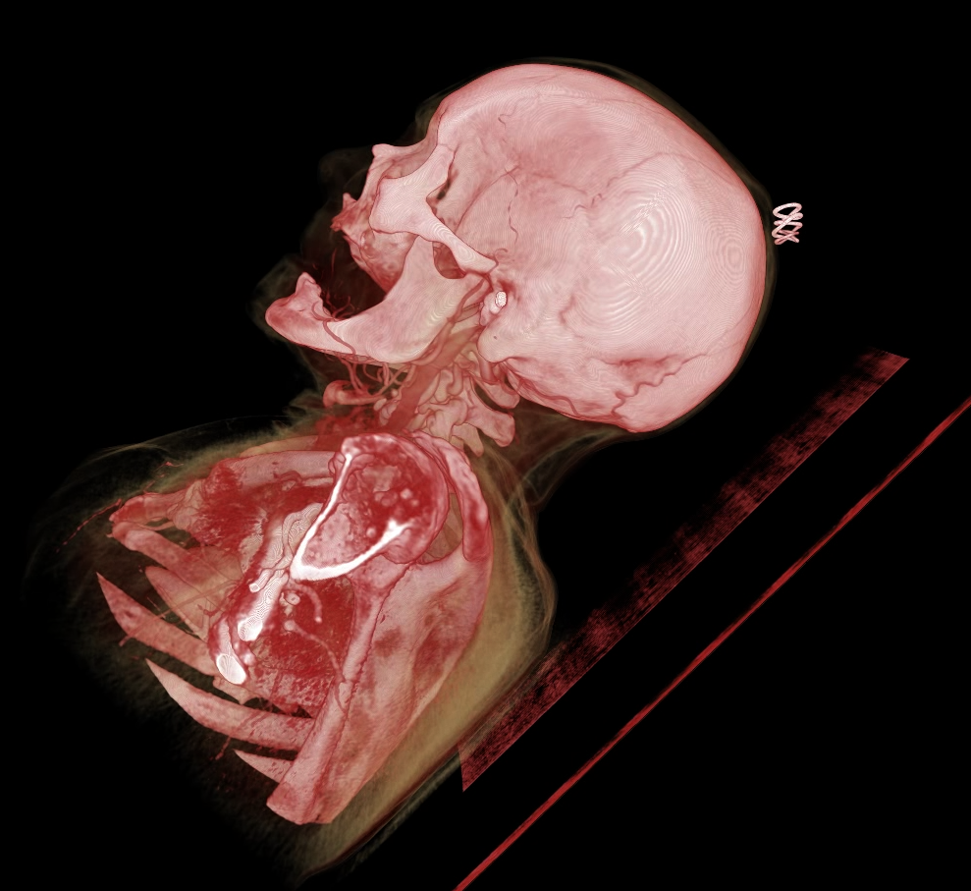
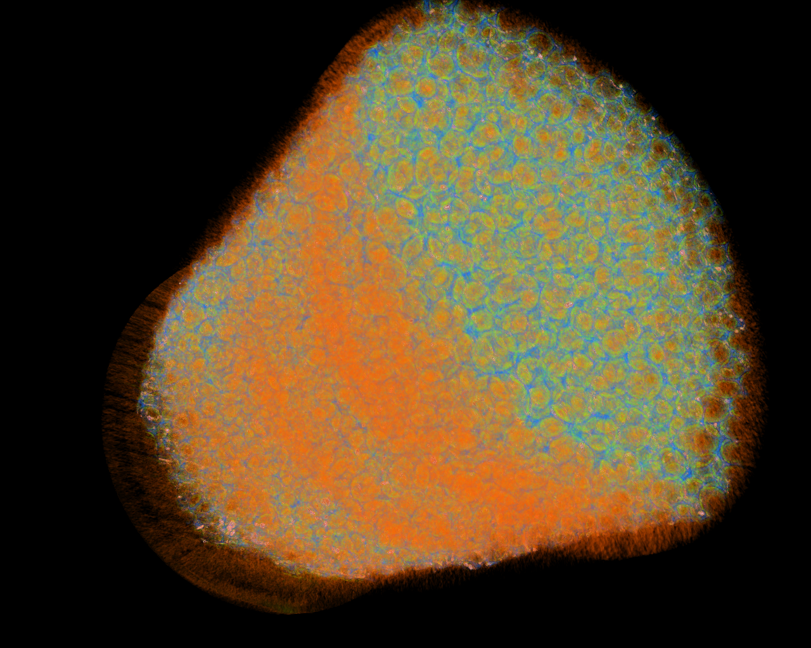
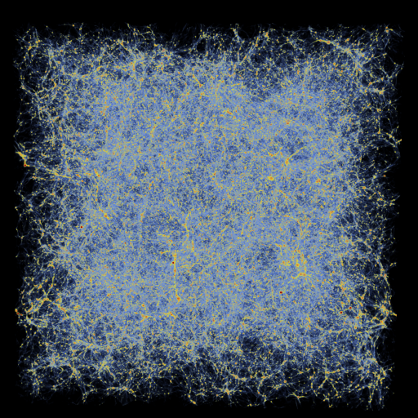
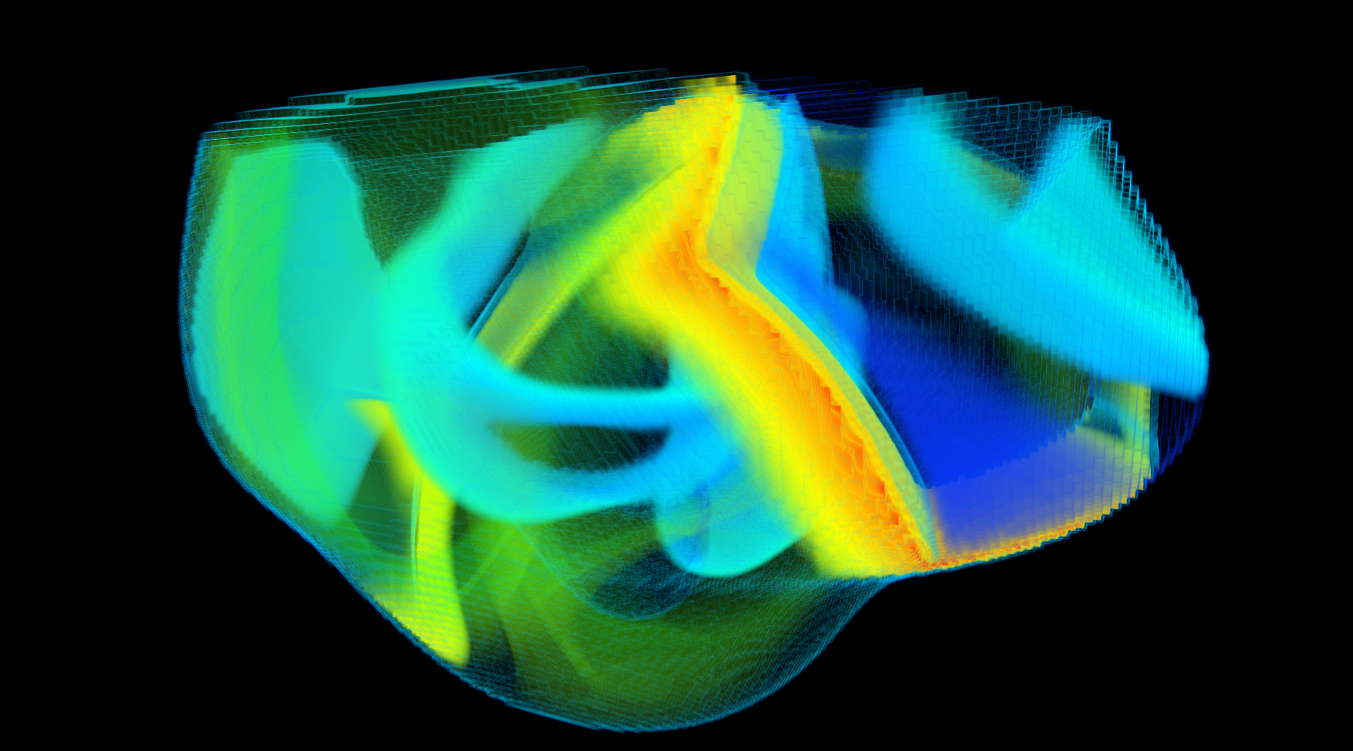
Fields using GPU Accelerators at Argonne
Computed Tomography
Micro-tomography
Cosmology
Bioengineering
Acknowledgement: Venkatram Vishwanath @ ANL
Notes:
Bioengineering - ALCF INCITE
Irregular heartbeats are one of the leading causes of death around the world. The treatment and prevention of cardiac rhythm disorders is extremely challenging as the electrical signal that control the heart's rhythm is controlled by a complex, multi-scale biological simulation. Jeff Fox (@ Cornell) is conducting large-scale simulations to model this.
Micottomography
This is experimental data from the Advanced Photon Source(APS) at ANL. THe data was generated by MSD researchers interested in understanding the internal structure of a foam material. This consisted of a stack of 2D slices and a total of 20GB of data.
Cosmology - INCITE
This simulation follows the growth of density perturbations in both gas and dark matter components in a volume 1 billion light years on a side beginning shortly after the Big Bang and evolved to half the present age of the universe. The animation illustrates the expansion of the universe over time, and highlights how individual structures (such as galaxy clusters) collapse due to gravity, while simultaneously being pushed further and further from each other.

Slide 3
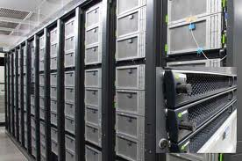
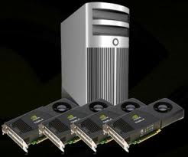
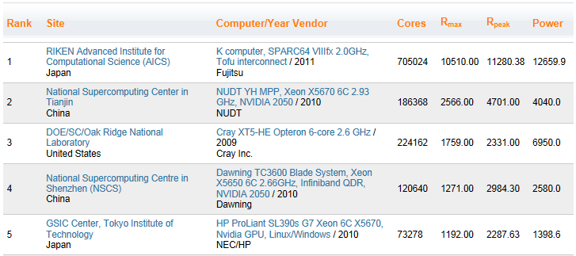
GPU-Based Supercomputers

Slide 4
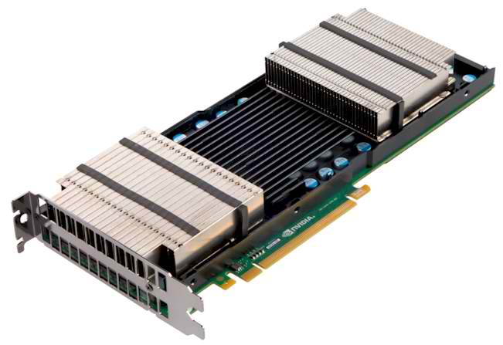
GPU-Accelerated High Performance Computing
GPUs are general purpose, highly parallel processors
High FLOPs/Watt and FLOPs/$
Unit of execution Kernel
Separate memory subsystem
Prog. Models: CUDA, OpenCL, …
Clusters with GPUs are becoming common
Multiple GPUs per node
Nonuniform node architecture
Node topology plays role in performance
New programmability and performance challenges for programming models and runtime systems
Keeneland Node Architecture

Slide 5
Heterogeneity and Intra-node GPU-GPU Xfers
GPU-GPU, Same I/O Hub
GPU-GPU, Diff. I/O Hub
CUDA provides GPU-GPU DMA using CUDA IPC
Same I/O hub – DMA best
Different I/O hubs – Shared memory best
Mismatch between PCIe and QPI ordering semantics

Slide 6
MPI-ACC: Programmability and Performance
GPU Global memory
Separate address space
Manually managed
Message Passing Interface
Most popular parallel programming model
Host memory only
Integrate accelerator awareness with MPI (ANL, NCSU, VT)
Productivity and performance benefits
GPU
CPU
Multiprocessor
MPI rank 0
MPI rank 1
MPI rank 2
MPI rank 3
Shared memory
Main memory
Global memory
PCIe, HT/QPI
NIC

Slide 7
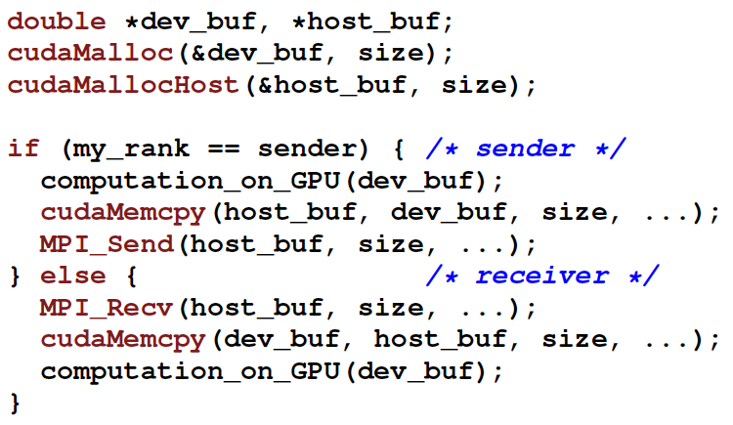
Current MPI+GPU Programming
MPI operates on data in host memory only
Manual copy between host and GPU memory serializes PCIe, Interconnect
Can do better than this, but will incur protocol overheads multiple times
Productivity: Manual data movement
Performance: Inefficient, unless large, non-portable investment in tuning

Slide 8
MPI-ACC Interface: Passing GPU Buffers to MPI
MPI-ACC Interface Cost (CPU-CPU)
Attributes
BUFTYPE=OCL
MPI Datatype
CL_Context
CL_Mem
CL_Device_ID
CL_Cmd_queue
Unified Virtual Address (UVA) space
Allow device pointer in MPI routines directly
Currently supported only by CUDA and newer NVIDIA GPUs
Query cost is high and added to every operation (CPU-CPU)
Explicit Interface – e.g. MPI_CUDA_Send(…), overloading
MPI Datatypes – Compatible with MPI and many accelerator models

Slide 9
MPI-ACC: Integrated, Optimized Data Movement
Use MPI for all data movement
Support multiple accelerators and prog. models (CUDA, OpenCL, …)
Allow application to portably leverage system-specific optimizations
Inter-node data movement [Aji HPCC’12]
Pipelining: Fully utilize PCIe and network links
GPU direct (CUDA): Multi-device pinning eliminates data copying
Handle caching (OpenCL): Avoid expensive command queue creation
Intra-node data movement
Shared memory protocol [Ji ASHES’12]
Sender and receiver drive independent DMA transfers
Direct DMA protocol [Ji HPCC’12]
GPU-GPU DMA transfer (CUDA IPC)
Both protocols needed, PCIe limitations serialize DMA across I/O hubs

Slide 10
Integrated Support for User-Defined Datatypes
MPI_Send(buffer, datatype, count, to, … )
MPI_Recv(buffer, datatype, count, from, … )
What if the datatype is noncontiguous?
CUDA doesn’t support arbitrary noncontiguous transfers
Pack data on the GPU [Jenkins ‘12]
Flatten datatype tree representation
Packing kernel that can saturate memory bus/banks

Slide 11
Intranode Communication in MPICH2 (Nemesis)
Rank 0
Rank 1
Rank 0
Rank 1
Shared Memory
Shared Memory
Rank 2
Rank 3
Rank 2
Rank 3
Short Message Transport
Shared message queue
Large, persistent queue
Single buffer transport
Large Message Transport
Point-to-point shared buffer
Ring buffer allocated at first connection
Multi-buffered transport

Slide 12
Non-integrated Intranode Communication
Process 0
Process 1
GPU
Host
Nemesis Shr. Memory
Communication without accelerator integration
2 PCIe data copies + 2 main memory copies
Transfers are serialized

Slide 13
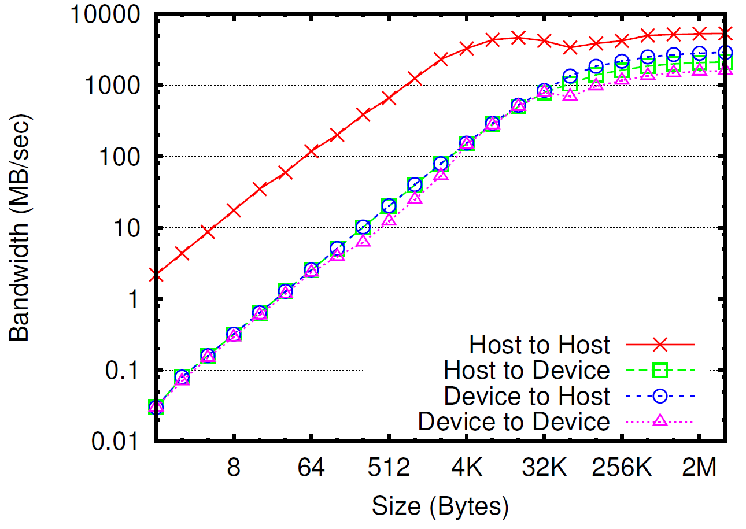
Performance Potential: Intranode Bandwidth
Bandwidth measurement when using manual data movement
Theoretical node bandwidth: 6 GB/sec
Achieved for host-host transfers
Observed bandwidth: 1.6 – 2.8 GB/sec
With one/two GPU buffers – one/two copies

Slide 14
Eliminating Extra Copies
Process 0
Process 1
GPU
Host
Nemesis Shr. Memory
Integration allows direct transfer into shared memory buffer
LMT: sender and receiver drive transfer concurrently
Pipeline data transfer
Full utilization of PCIe links

Slide 15
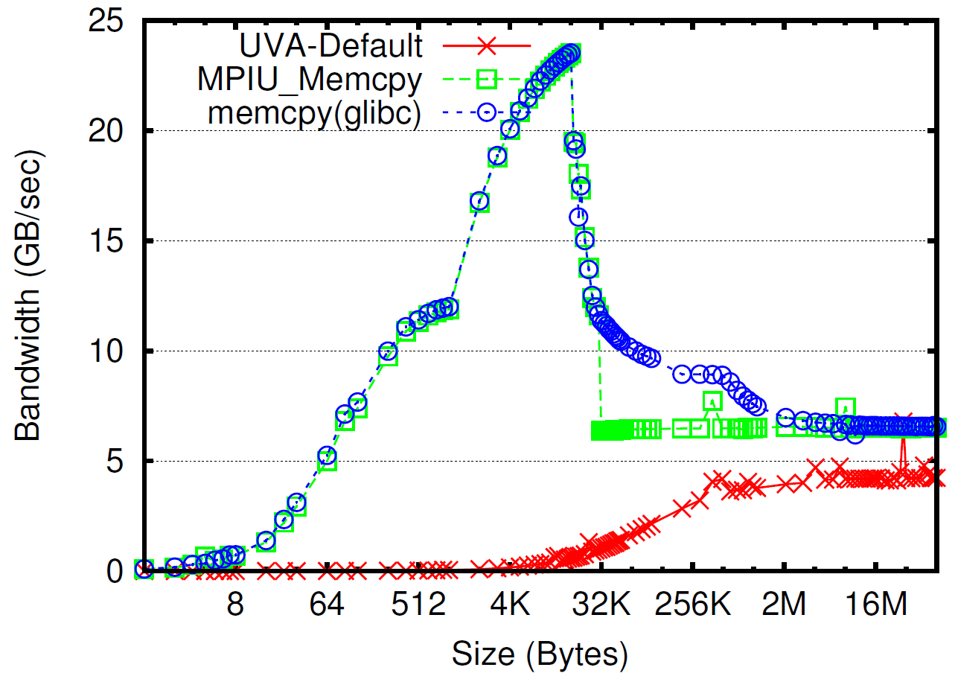
Copying Data Between Host and Device
Host to Device
Host to Host
Three choices for selecting the right copy operation:
UVA-Default: Use cudaMemcpy(…, cudaMemcpyDefault)
Query-and-copy: UVA query buffer type
Dispatch memcpy or cudaMemcpy
Parameterized-copy: Pass parameter for each buffer
Dispatch memcpy or cudaMemcpy

Slide 16
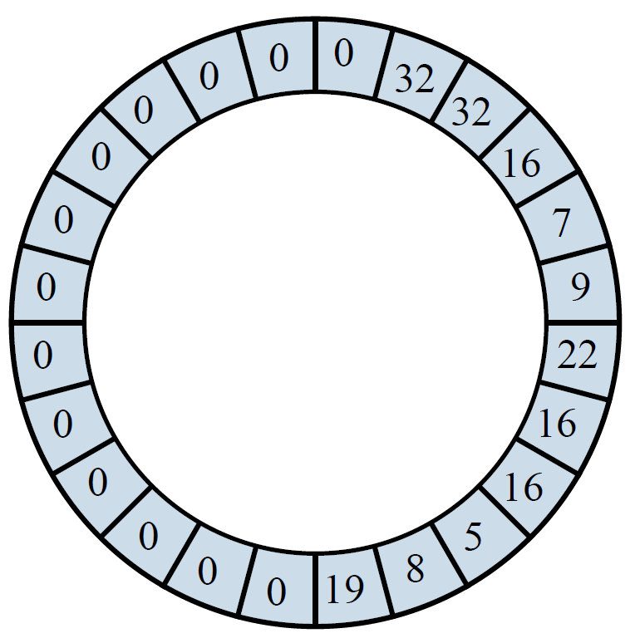
Large Message Transport Protocol
Shared buffer mapped between pairs of communicating processes
Enables pipelined transfer
Sender and receiver drive DMA concurrently
Fixed-size ring Buffer
Set of fixed-size partitions
R - receiver’s pointer
S - sender’s pointer
Partition size
Set to data length by Sender
Set to zero by Receiver
R
S

Slide 17
Extending LMT Protocol to Accelerators
Sender and receiver issue asynchronous PCIe data transfers
Add Ra and Sa pointers
Mark section of R/S segment in use by PCIe transfers
Proactively generate PCIe data transfers
Move to the next partition
Start new PCIe data copy
Repeat until full or RB is empty
Update R/S when checking PCIe operations later
R
Ra
Sa
S

Slide 18
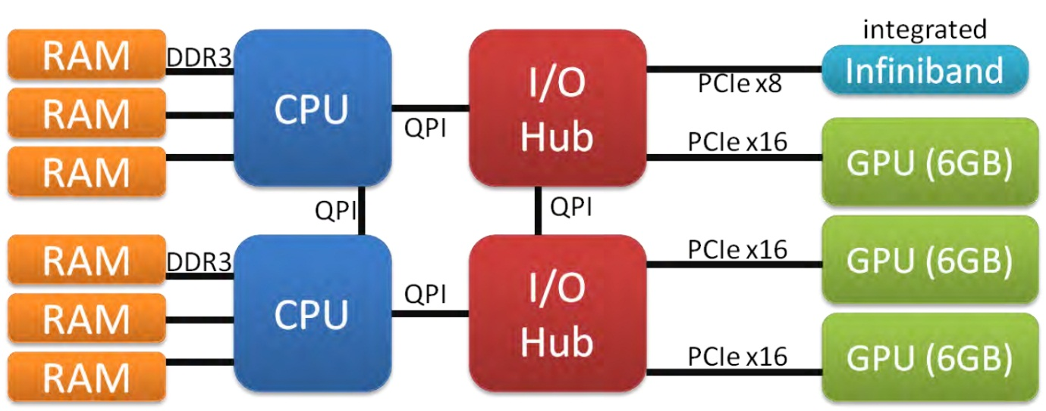
Experimental Evaluation
Keeneland node architecture
2x Intel Xeon X5660 CPUs, 24 GB Memory, 3x Nvidia M2070 GPUs
Parameter optimization: shared ring buffer and message queue
Communication benchmarking: OSU latency/bw
Stencil2D from SHOC benchmark suite

Slide 19
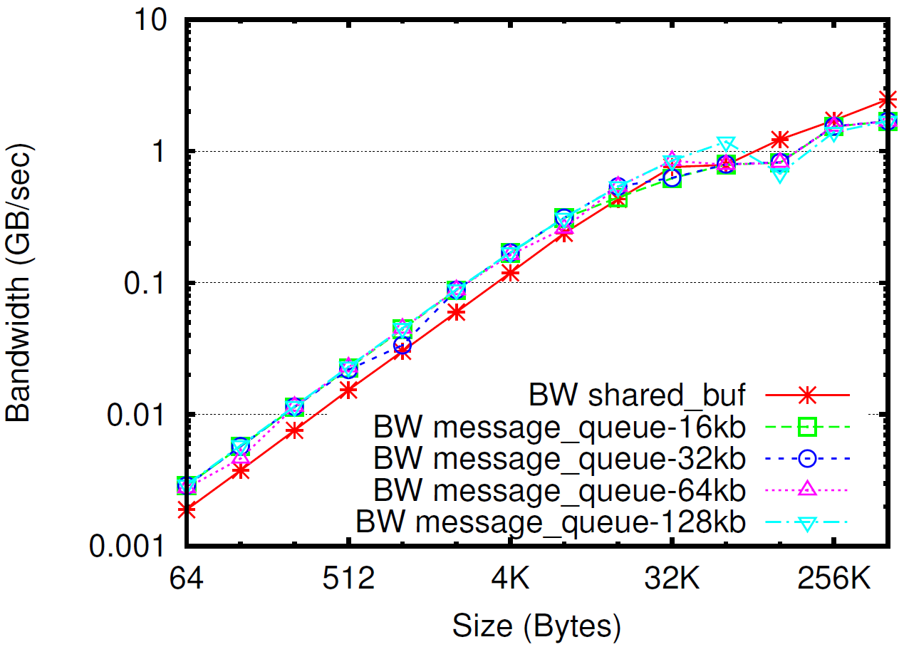
Eager Parameters: Message Queue Element Size and Eager/LMT Threshold
GPU-GPU transfer of varying size
“Shared buf” is manual data transfer
Large message queue can support more requests
Eager up to 64 kB, LMT for +64 kB
The same value as host-only

Slide 20
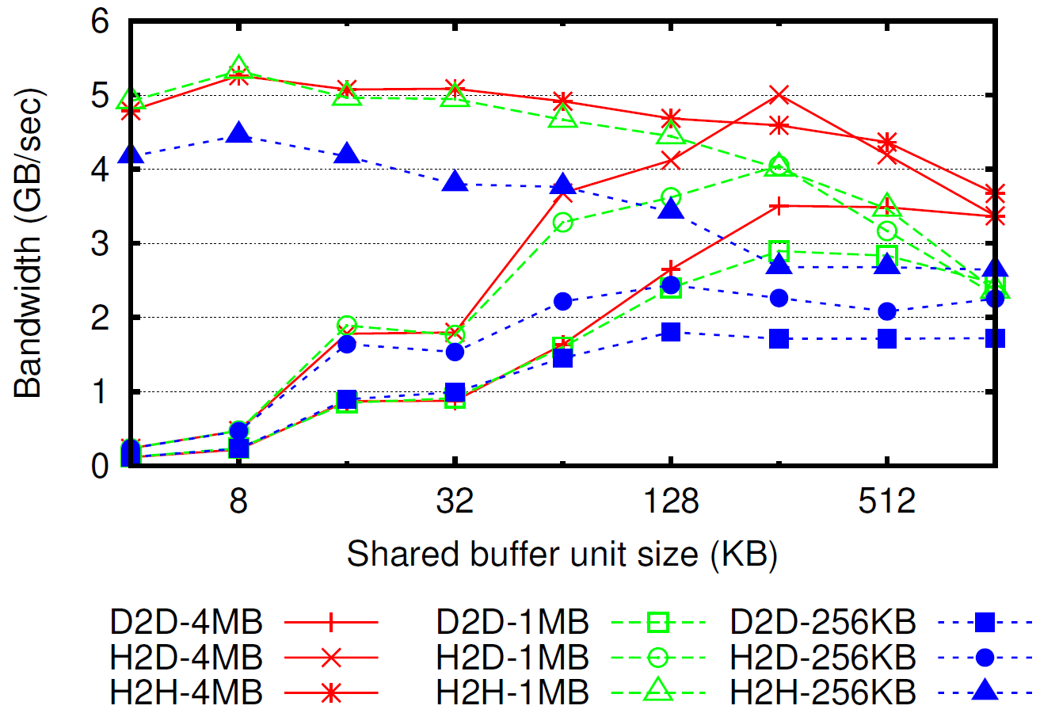
LMT Parameter: Shared Ring Buffer Unit Size
Host-to-host
Default buffer unit size 32 KB
GPU involved
Use 256 KB
PCIe bandwidth favors larger messages
Parameter choice requires knowledge of buffer locations on sender and receiver
Exchange information during handshaking phase of LMT protocol
Intranode bandwidth – two processes

Slide 21
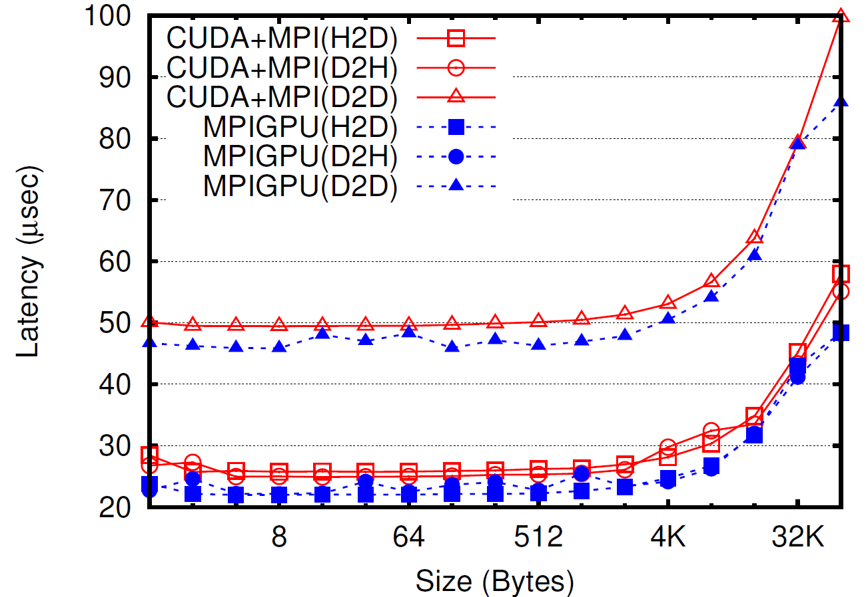
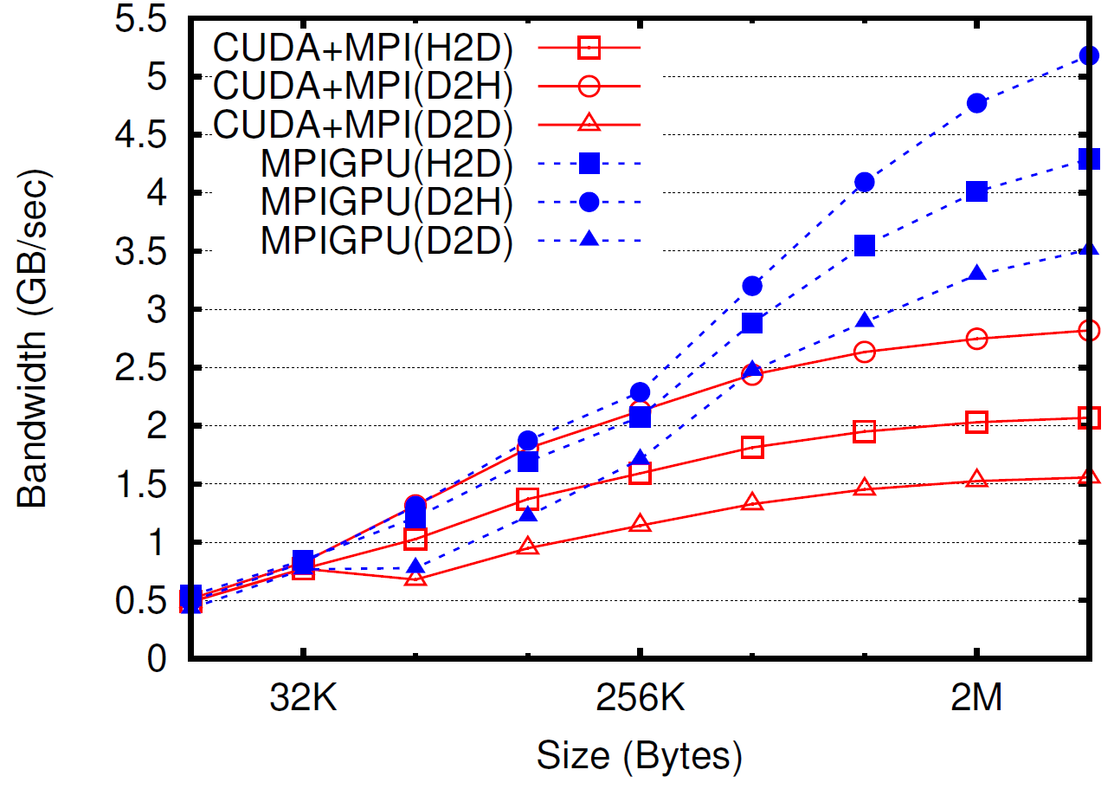
Latency & Bandwidth Improvement
Less impact on D2D case
PCIe latency dominant
Improvement: 6.7% (D2D), 15.7% (H2D), 10.9% (D2H)
Bandwidth discrepancy in different PCIe bus directions
Improvement: 56.5% (D2D), 48.7% (H2D), 27.9% (D2H)
Nearly saturates peak (6 GB/sec) in D2H case

Slide 22
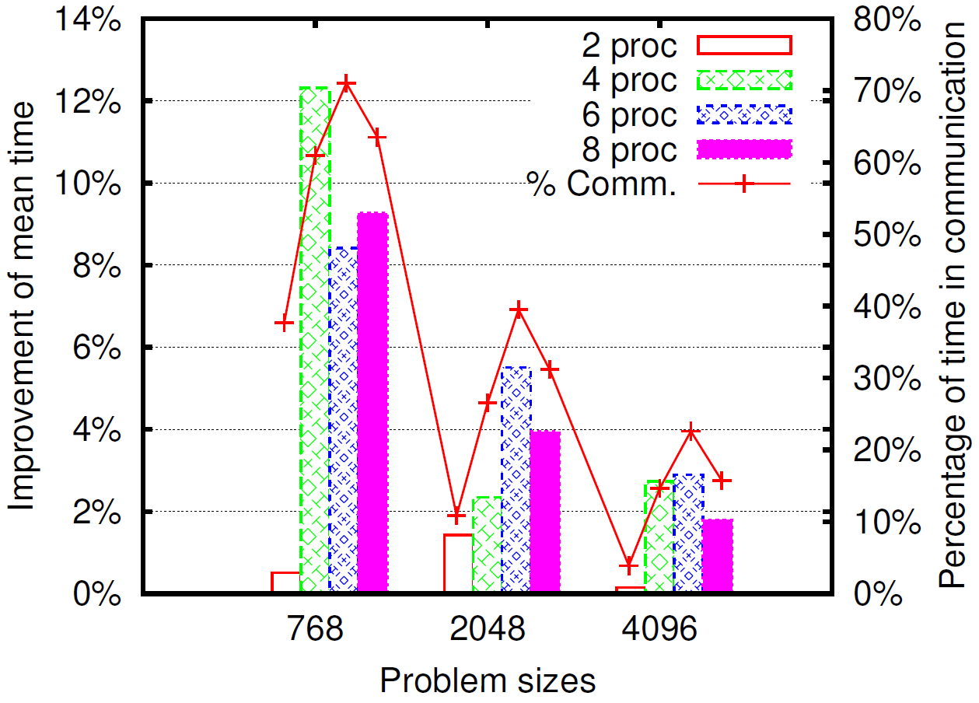
Application Performance: Stencil2D Kernel
Nine-point stencil computation, SHOC benchmark suite
Halo exchange with neighboring processes
Benefit from latency improvement
Relative fraction of communication time decreases with problem size
Average execution time improvement of 4.3%

Slide 23
Conclusions
Accelerators are ubiquitous, moving target
Exciting new opportunities for systems researchers
Requires evolution of HPC software stack
Integrate accelerator-awareness with MPI
Support multiple accelerators and programming models
Goals are productivity and performance
Optimized Intranode communication
Eliminate extra main memory copies
Pipeline data flow in ring buffer
Optimize data copying

Slide 24
Questions?

Slide 25
Backup Slides

Slide 26
Host-side Memcpy Bandwidth

