Slide 1
A Study of Hardware Assisted IP over InfiniBand and its Impact on Enterprise Data Center Performance
Ryan E. Grant¹, Pavan Balaji², Ahmad Afsahi¹
¹Department of Electrical and Computer Engineering
Queen’s University Kingston, ON, Canada K7L 3N6
²Mathematics and Computer Science
Argonne National Laboratory
Argonne, IL, USA

Slide 2
Introduction
Motivation
Background Information
Experimental Framework
Experimental Results
Baseline Performance
Offloading Performance
Data Center Performance Results
Performance Bottleneck Investigation
Validation
Conclusions
Future Work
Questions

Slide 3
Motivation
Sockets-based protocols are used extensively in enterprise data centers
IPoIB provides a high performance socket interface that does not rely on upper layer protocol support (such as TCP)
Future convergence of networking fabrics, will use elements of InfiniBand and Ethernet
Behaviour and performance of such systems is important to study in order to guide the development and installation of advanced networking technologies

Slide 4
Motivation
Why is UD/RC offloading important?
Its new to IPoIB (UD offloading)
It narrows the performance gap between IPoIB-UD and Sockets Direct Protocol (SDP)
UD offloading allows us to effectively use software that does not utilize TCP (TCP is required for SDP)

Slide 5
Outline
Motivation
Background Information
Experimental Framework
Experimental Results
Baseline Performance
Offloading Performance
Data Center Performance Results
Performance Bottleneck Investigation
Validation
Conclusions
Future Work
Questions

Slide 6
Background Information
InfiniBand
Queue Pair Operation, supporting RDMA and send/receive modes
Mellanox ConnectX host channel adapters support 4x InfiniBand operation
Bandwidth of 40 Gigabit/s (32 Gigabits/s data)
The OpenFabrics Enterprise Software Distribution (OFED-1.4) (InfiniBand drivers) supports both SDP and IPoIB protocols

Slide 7
Background Information
Socket-based protocols provide IP functionality, using IP over IB (IPoIB)
IPoIB provides Large receive offload (LRO) and Large send offload (LSO)
Large receive offload aggregates incoming packets
Large send offload segments large messages into appropriate packet sizes in hardware
Sockets Direct Protocol (SDP) provides RDMA capabilities
Bypasses the operating system’s TCP/IP stack
Utilizes hardware flow control, offloaded network and transport stack in addition to RDMA
Operates in buffered-copy and zero-copy modes

Slide 8
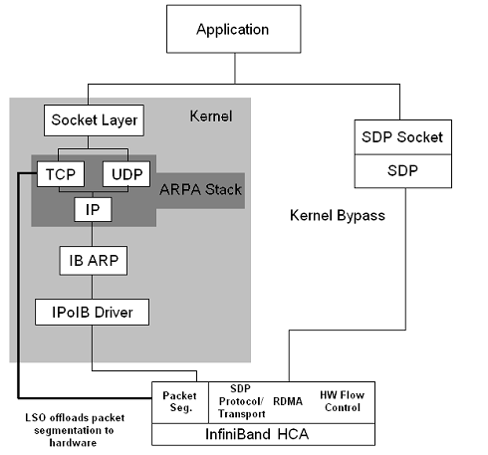
Background Information

Slide 9
Background Information
InfiniBand operates in several modes:
Reliable Connection (RC): Keeps traditional connections while offering low level reliability and in order delivery
Unreliable Datagram (UD): non-connection based datagram transmission, with no reliability
IB is capable of RDMA, which is utilized for socket interfaces through the SDP API which replaces TCP programming semantics
Additional IB modes: unreliable connection and reliable datagram, do not currently have hardware offloading implementations

Slide 10
Outline
Motivation
Background Information
Experimental Framework
Experimental Results
Baseline Performance
Offloading Performance
Data Center Performance Results
Performance Bottleneck Investigation
Validation
Conclusions
Future Work
Questions

Slide 11
Experimental Framework
Network performance data was collected using Netperf-2.4.4
Performance was validated using iperf-2.0.4
OS | Processors | InfiniBand HCA | Switch | OFED version
Fedora Kernel 2.6.27 | 2 – 2.0 Ghz Quad-Core AMD Opteron | ConnectX 4X DDR HCA Firmware: 2.6.11 | Mellanox 24-port MT47396 Infiniscale-III | 1.4

Slide 12
Baseline Performance Results
As expected Verbs RDMA and SDP (RDMA) show major latency advantages for small messages over IPoIB

Slide 13
Baseline Multi-Stream Performance
The use of multiple streams for IPoIB shows good performance for IPoIB-RC/UD while IPoIB RC/UD and SDP Buffered copy are comparable

Slide 14
Offloading Performance
IPoIB-UD with offloading provides similar latency to that of IPoIB-RC

Slide 15
Offloading Performance
Although IPoIB-UD offloading outperforms non-offloaded IPoIB-UD, the single stream is still outperformed by IPoIB-RC

Slide 16
Offloading Performance
With multiple streams, IPoIB-UD-LRO-LSO outperforms IPoIB-RC, and greatly outperforms non offloaded IPoIB-UD

Slide 17
Offloading Performance
Offloaded IPoIB-UD provides a 85.1% improvement in bandwidth over non-offloaded IPoIB-UD
Offloaded IPoIB-UD outperforms Multi-stream IPoIB-RC by 7.1%, and provides similar latency
Offloaded IPoIB-UD provides bandwidth only 6.5% less than that of SDP

Slide 18
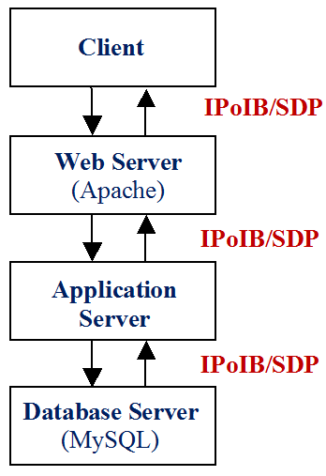
Data Center Performance

Slide 19
Data Center Performance
Data center throughput shows IPoIB-UD-LRO-LSO to maintain the highest level of throughput, while SDP is unexpectedly the worst performer of the group
Notes:
Similar patterns on all results except for CG

Slide 20
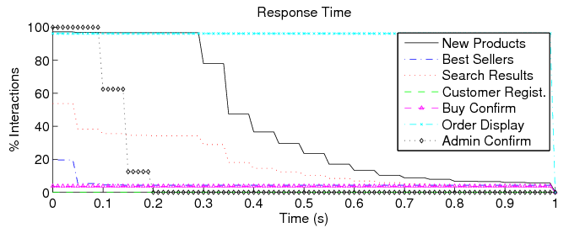
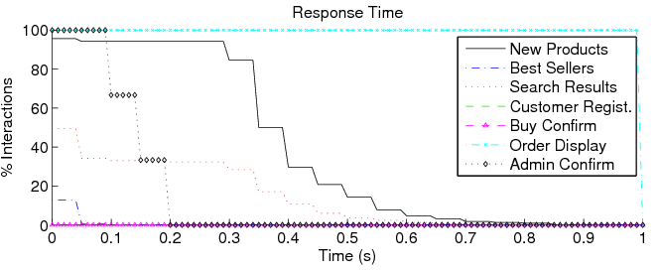
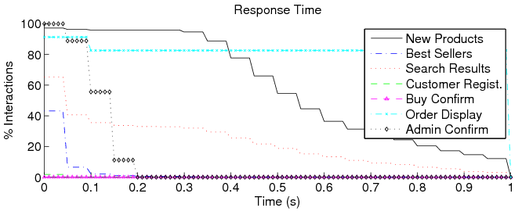
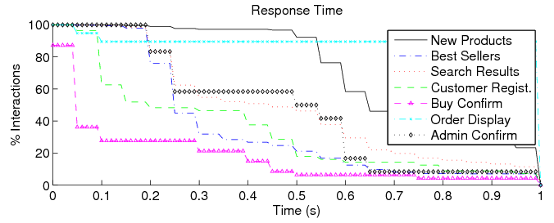
Data Center Performance
IPoIB-UD-LRO-LSO
IPoIB-RC
IPoIB-UD-noLRO-noLSO
SDP

Slide 21
Data Center Performance
IPoIB-UD-LRO-LSO provides the highest sustained bandwidth of all of the protocols, beating non-offloaded IPoIB-UD by 15.4% and IPoIB-RC by 5.8% and SDP by 29.1%
IPoIB-UD-LRO-LSO provides similar response time to its nearest competitor, IPoIB-RC
All of the IPoIB configurations provide higher bandwidth than SDP

Slide 22
Performance Bottleneck Investigation
SDP shows poor throughput and latency, much worse than would be initially expected
Given the excellent performance of SDP at the micro-benchmarks level, several tests were conducted to determine the cause of SDP’s poor performance in the data center test
It was determined that the large number of simultaneous connections were causing poor performance with SDP
The number of connections used by the SDP data center were reduced while increasing the activity level of each connection to confirm this analysis

Slide 23
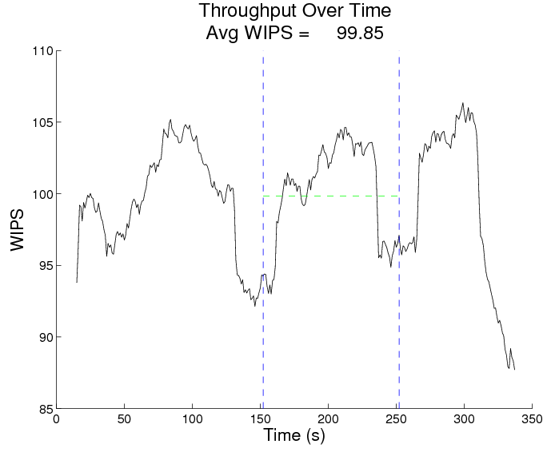
Performance Investigation
The resulting performance of SDP (with 50 connections) is increased greatly to a level that is more inline with expectations

Slide 24
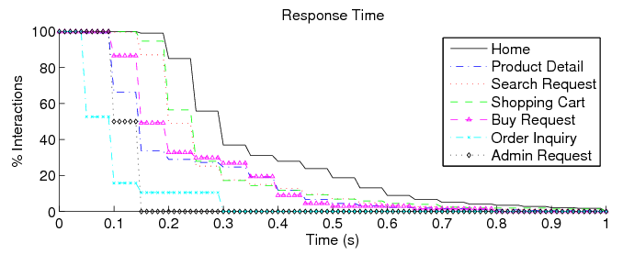
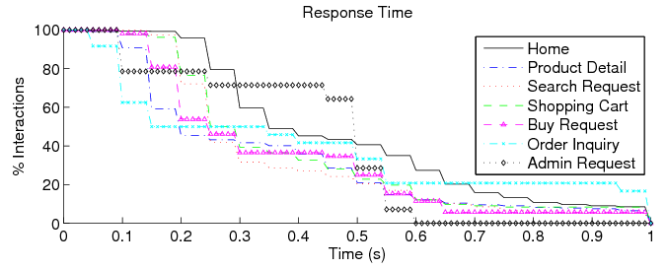
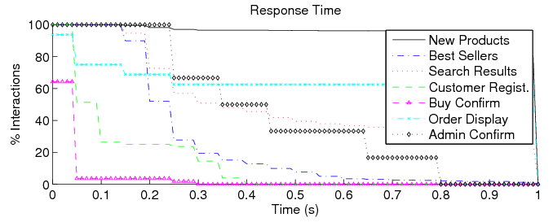
Performance Investigation
SDP delay - with fewer connections
SDP delay - with many connections

Slide 25
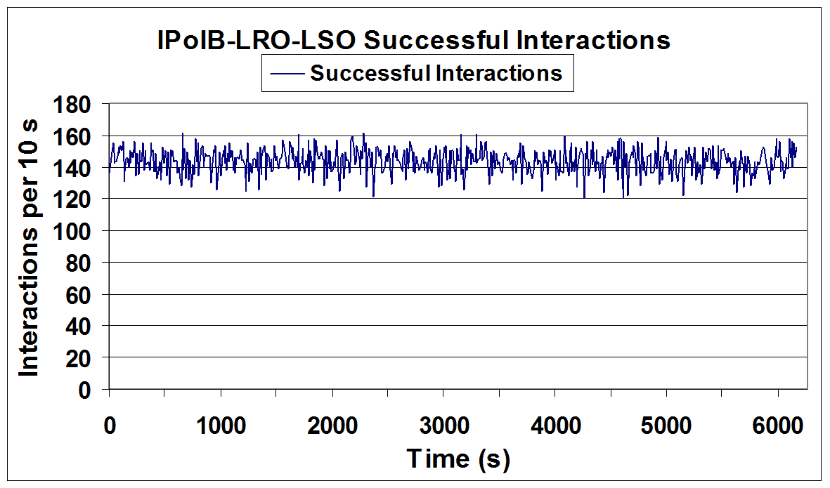
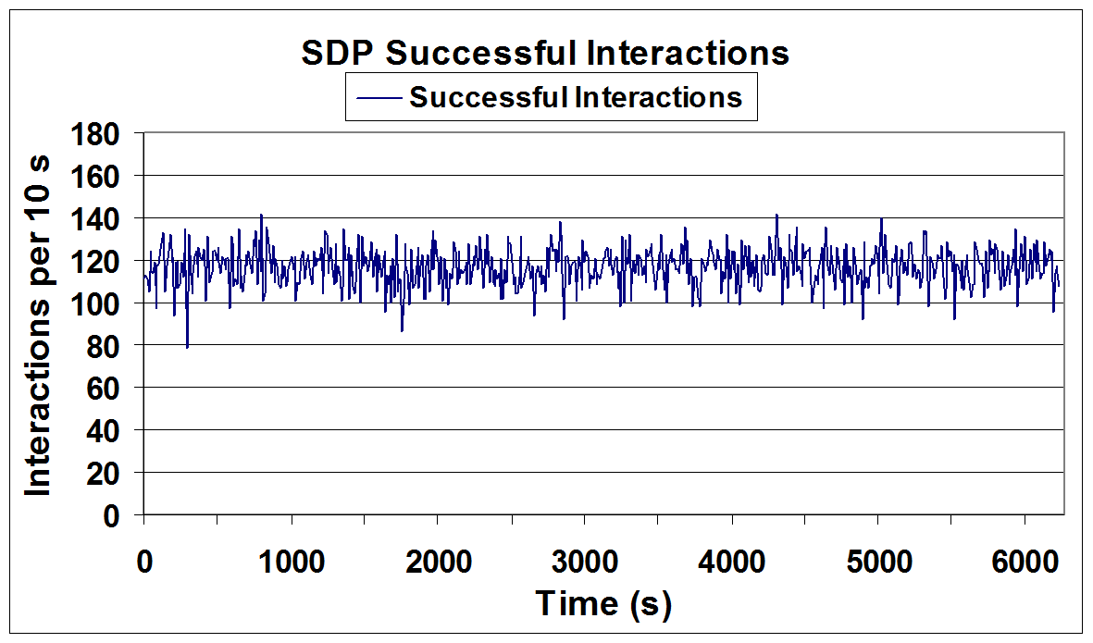
Performance Validation
IPoIB and SDP show similar performance results on SPECWeb as were seen using the TPC-W benchmarks

Slide 26
Performance Validation
SPECWeb response time results show IPoIB-UD-LRO-LSO to have the overall lowest response times

Slide 27
Outline
Motivation
Background Information
Experimental Framework
Experimental Results
Baseline Performance
Offloading Performance
Data Center Performance Results
Performance Bottleneck Investigation
Validation
Conclusions
Future Work
Questions

Slide 28
Conclusions
Micro-benchmarks have shown a 85.1% improvement in bandwidth of offloaded IB-UD over the non-offloaded case and a 26.2% maximum reduction in latency
Offloaded IPoIB-UD shows a 15.4% improvement in throughput over non offloaded IPoIB-UD
IPoIB-UD-LRO-LSO has a 29.1% higher throughput than SDP in our data center testing
The benefits of using IPoIB-RC are minimal over those of IPoIB-UD when utilizing offloading capabilities
Therefore, for future networks such as CEE the inclusion of a reliable connection mode is most likely unnecessary

Slide 29
Future Work
Resolving the issues holding back SDP performance when using large numbers of connections
Utilizing Quality of Service to further enhance enterprise data center performance
Combining IPoIB-UD, QoS and Virtual Protocol Interconnect to improve overall data center performance

Slide 30
Questions?
Thank You
Questions?

